Slide 1

RECENT DEVELOPMENTS AND APPLICATIONS OF THE EPOGS AUTO-MESHING TOOLSET
William M. Chan, Andrew M. Chuen, Jeffrey A. Housman, Chase P. Ashby
Computational Aerosciences Branch
NASA Ames Research Center
17th Symposium on Overset Composite Grids and Solution Technology
State College, PA, Sept 21-24, 2026
This material is a work of the U.S. Government and is not subject to copyright protection in the United States.

Slide 2
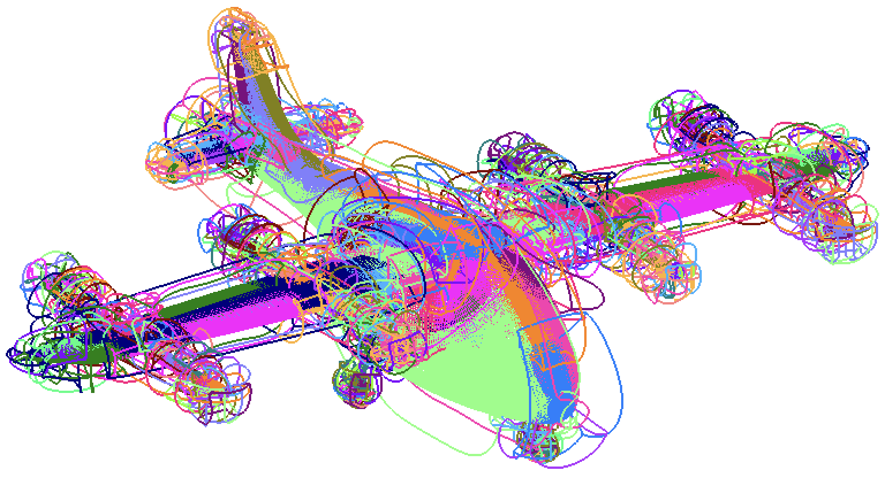
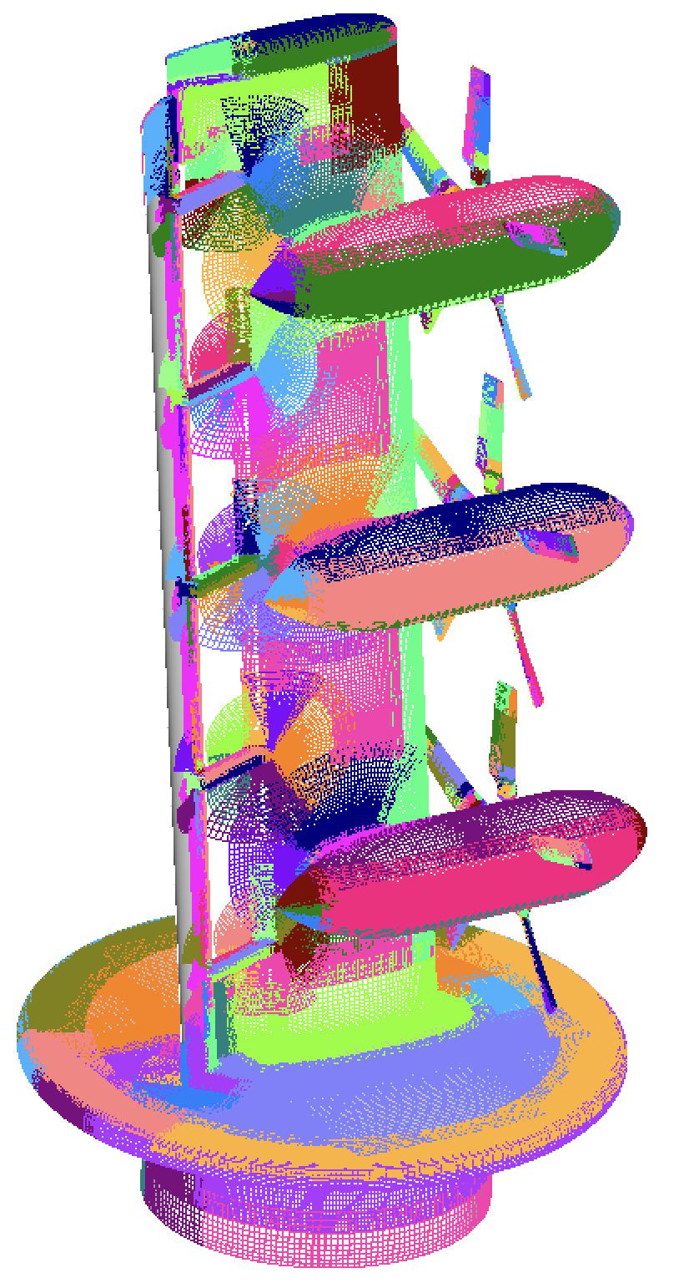
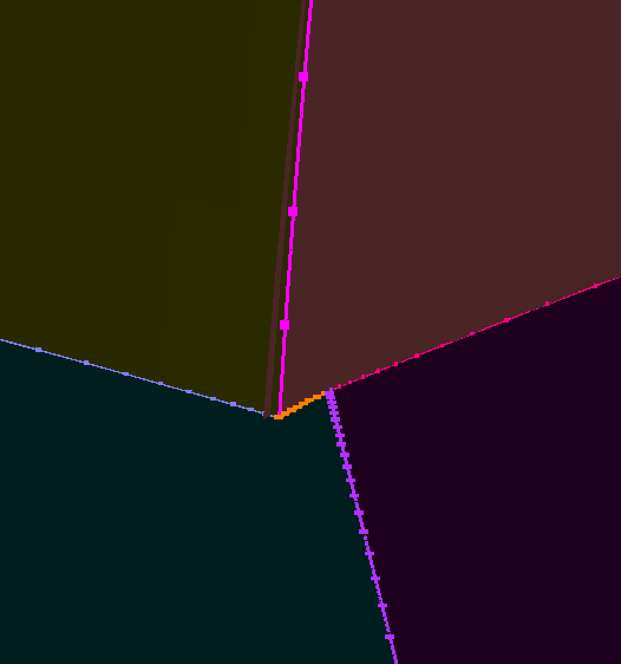
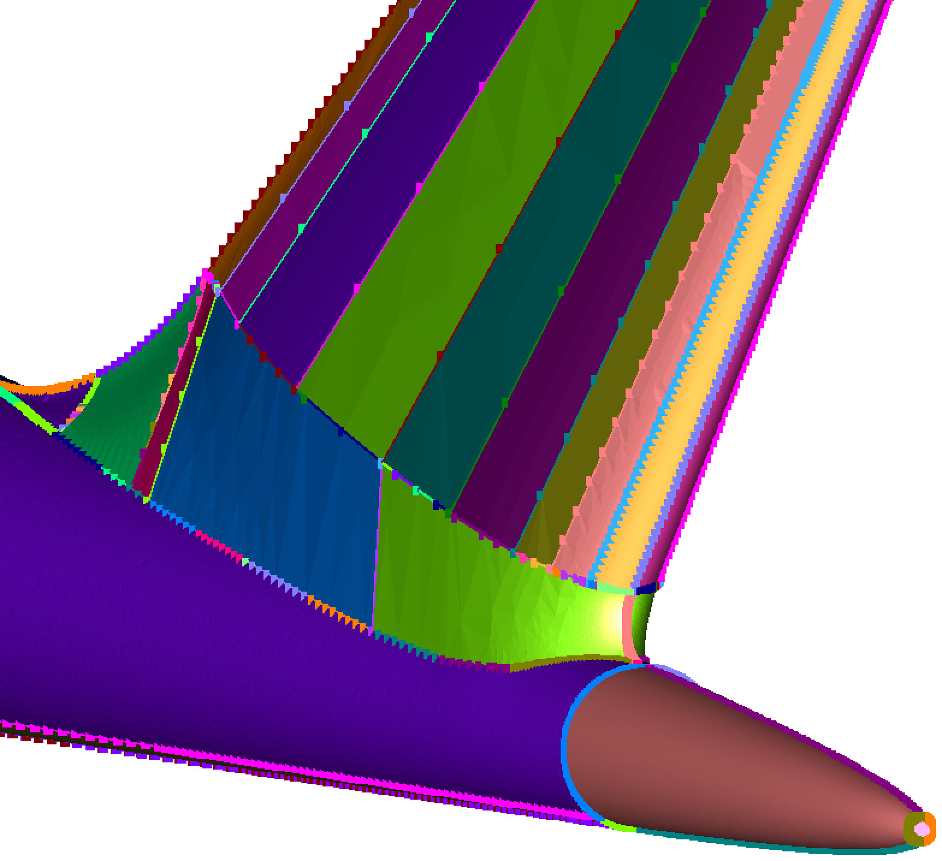
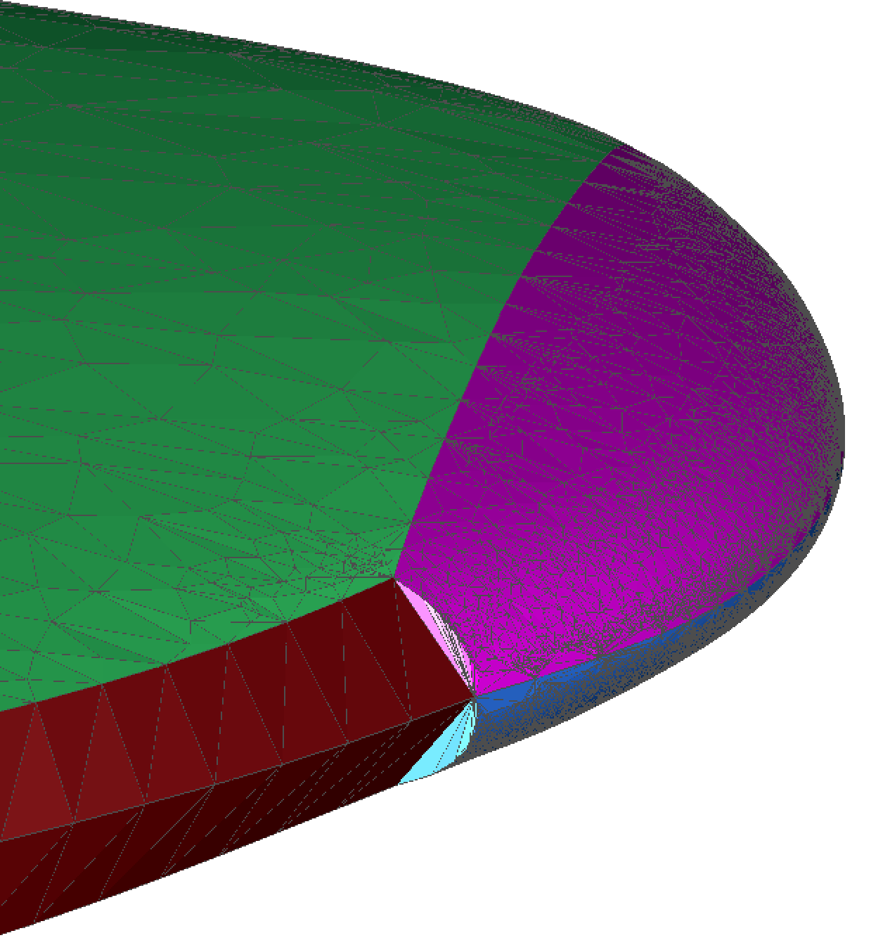
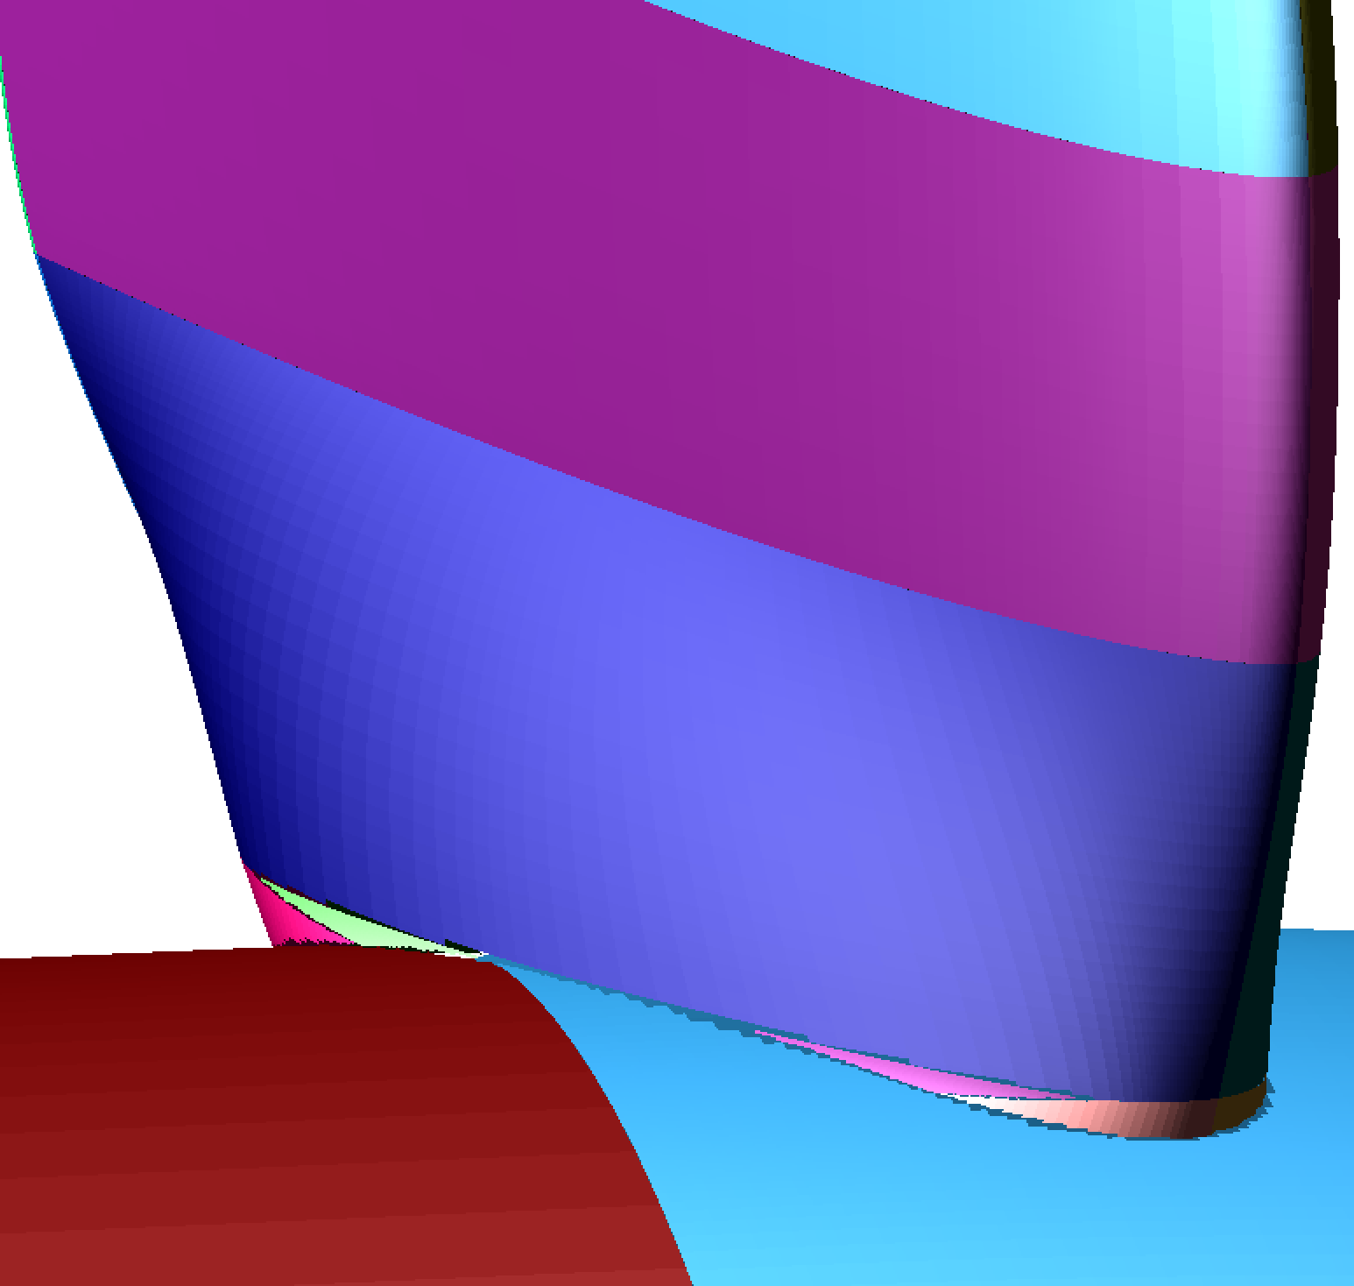
MOTIVATION & OBJECTIVES
CGT 3.0 - EPOGS meshing: weeks to days, days to hrs
Outstanding problems
  Input geometry needs to be a clean BREP solid
    Tedious repairs are frequently needed to
      Fix surface mismatches due to tolerance issues
      Merge fractured faces and edges
      Remove/merge small faces and edges
      Resolve native CAD to .stp/.igs translation errors
  About 0 - 5% of meshes need manual repairs
    Mesh overlap
    Negative Jacobians
(AIAA Paper 2026-4121)
Current talk
Alternative geometry starting points
Recent test cases (after CGT 3.0)

Slide 3
OUTLINE
Motivation & objectives
Automation scheme review
EPOGS workflow
EPOGS starting points
Recent test cases
Concluding remarks

Slide 4
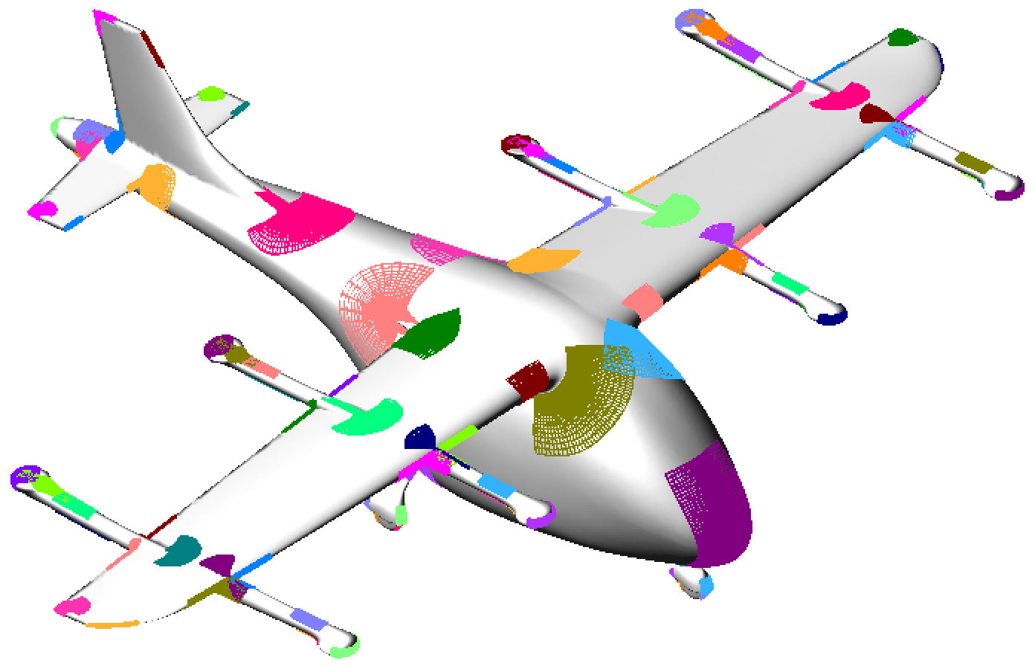
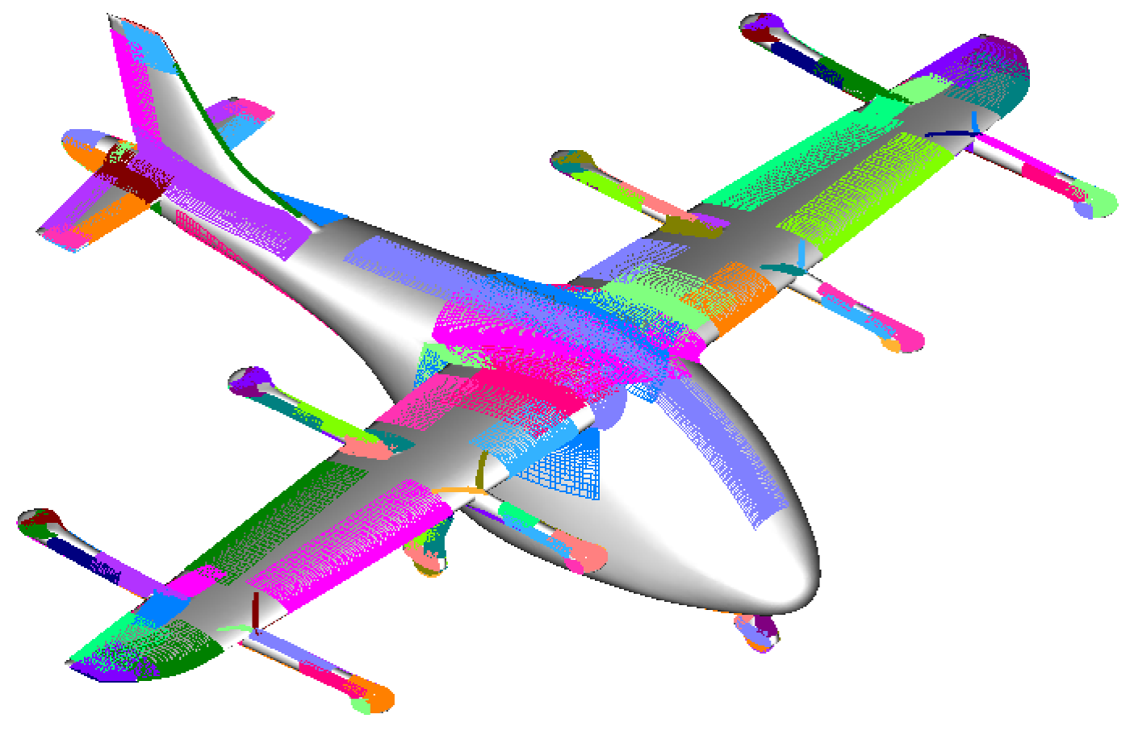
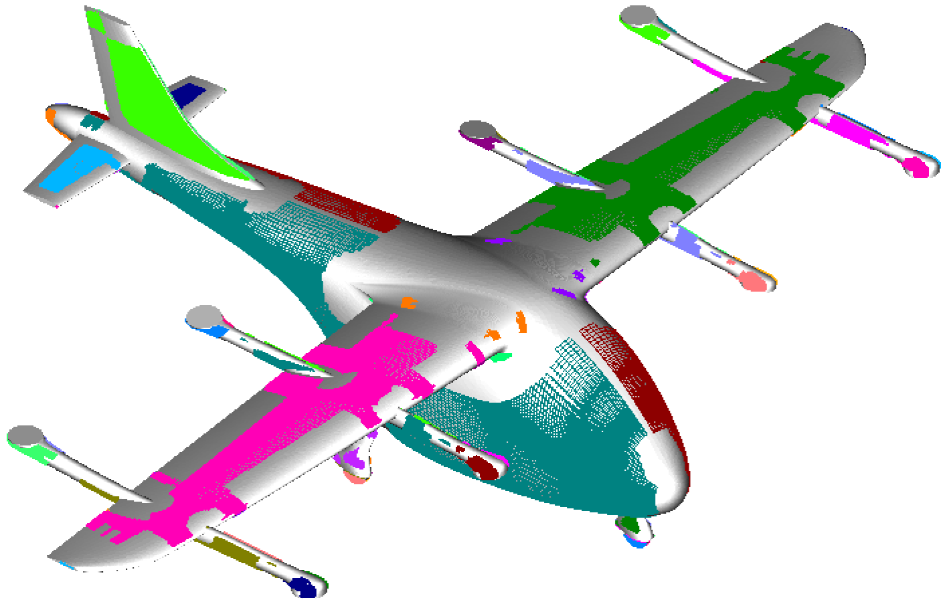
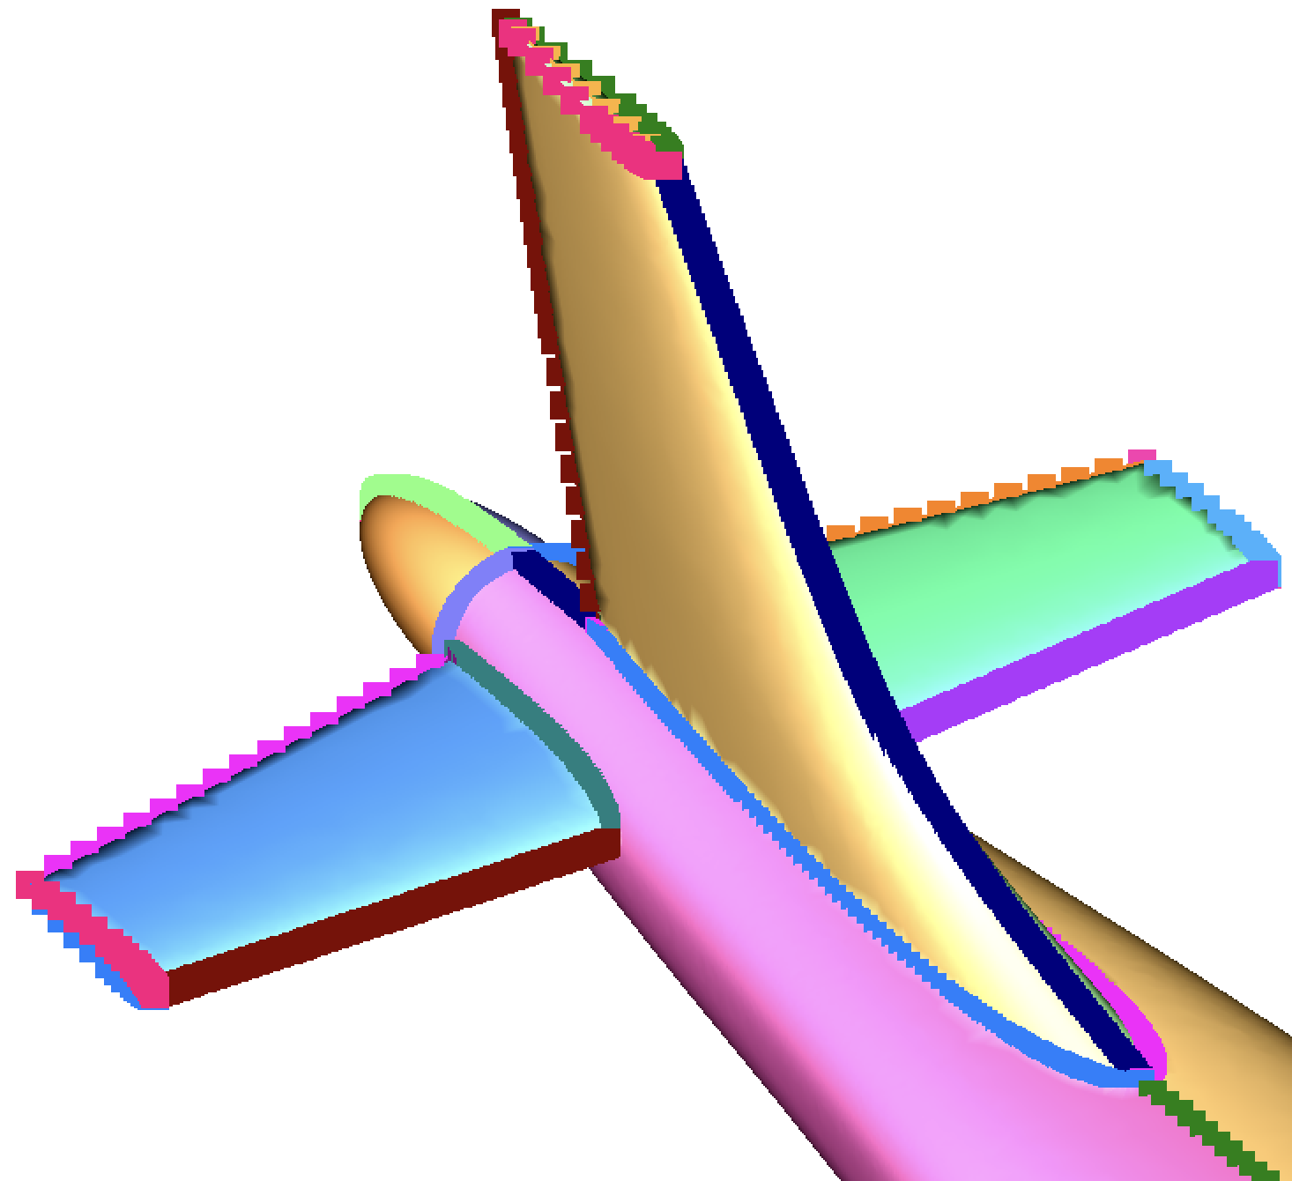
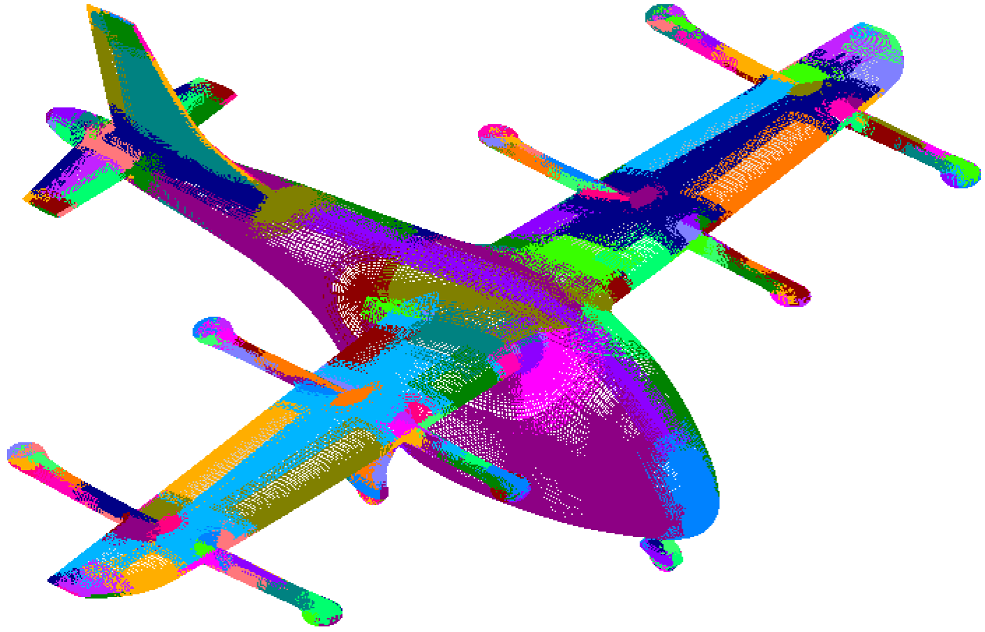
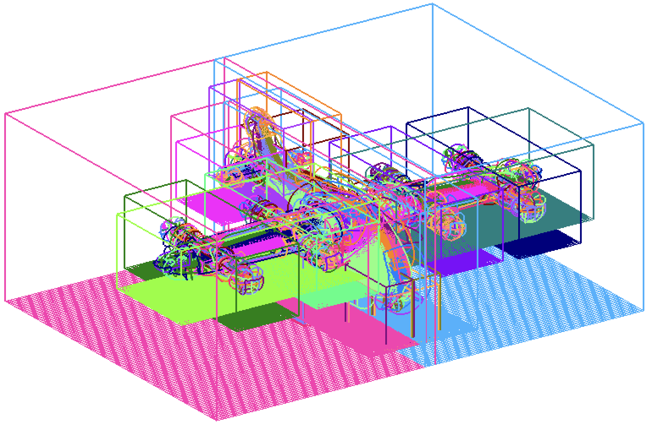
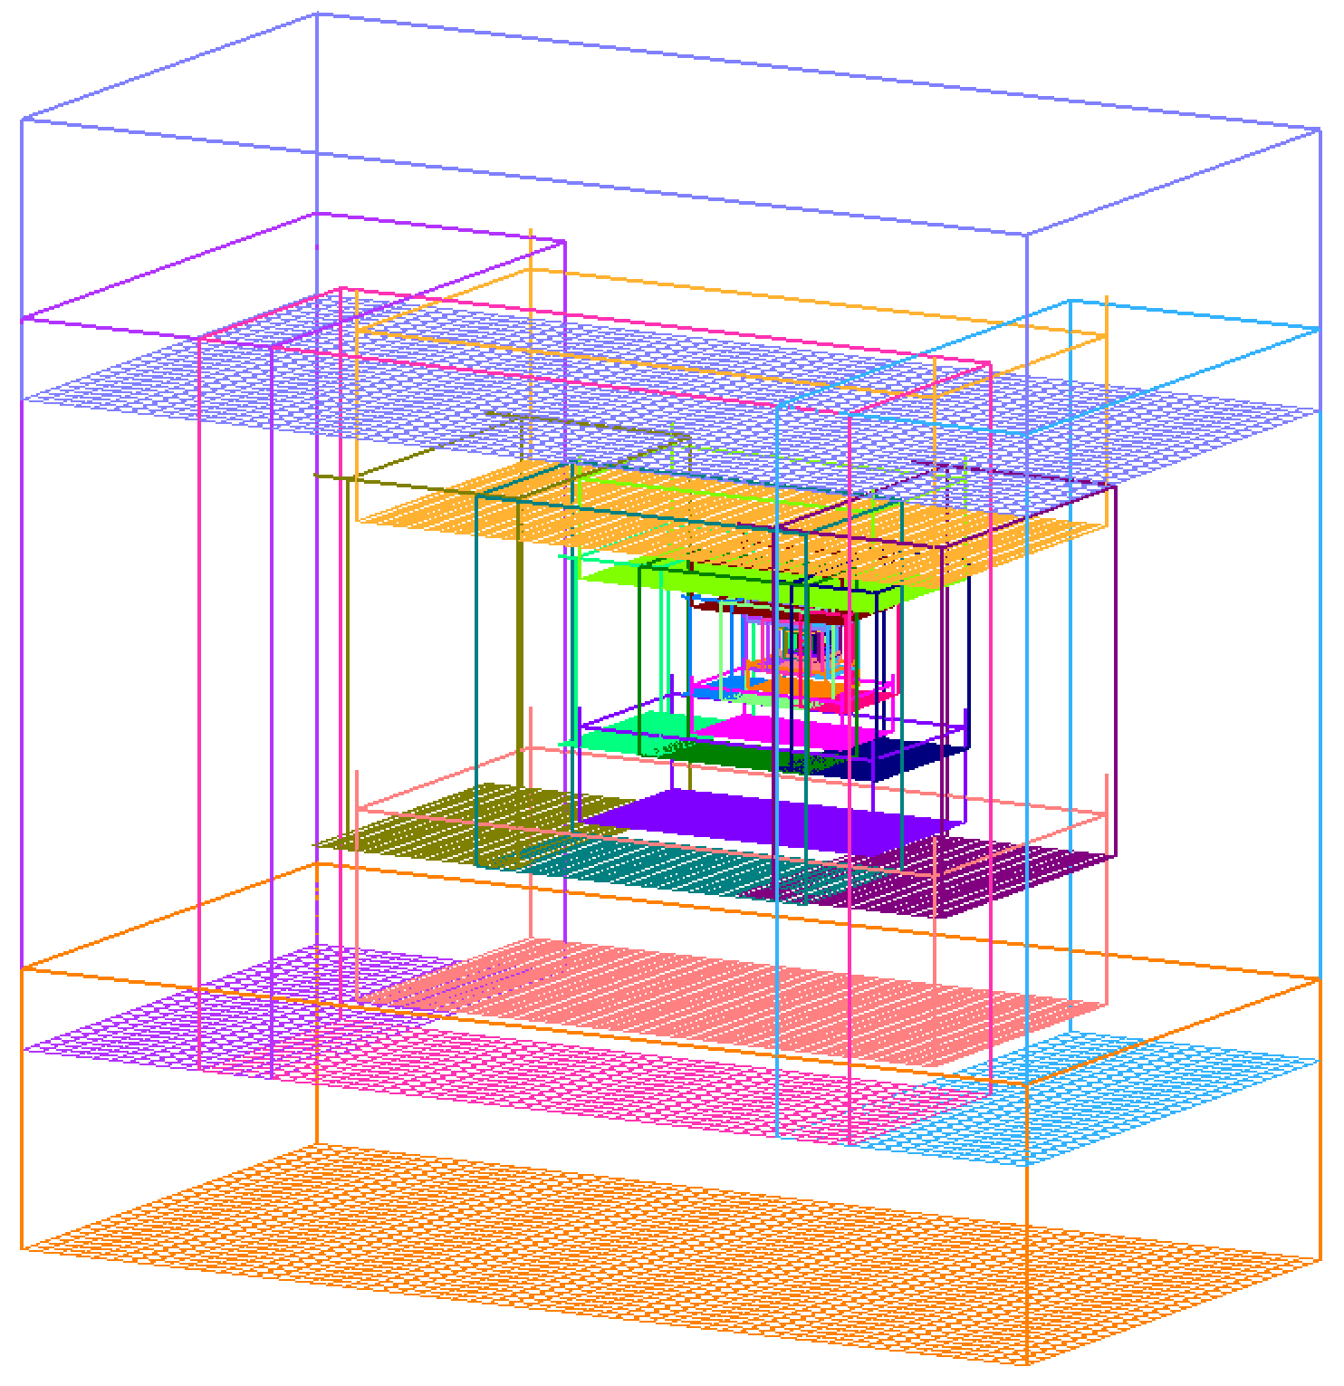
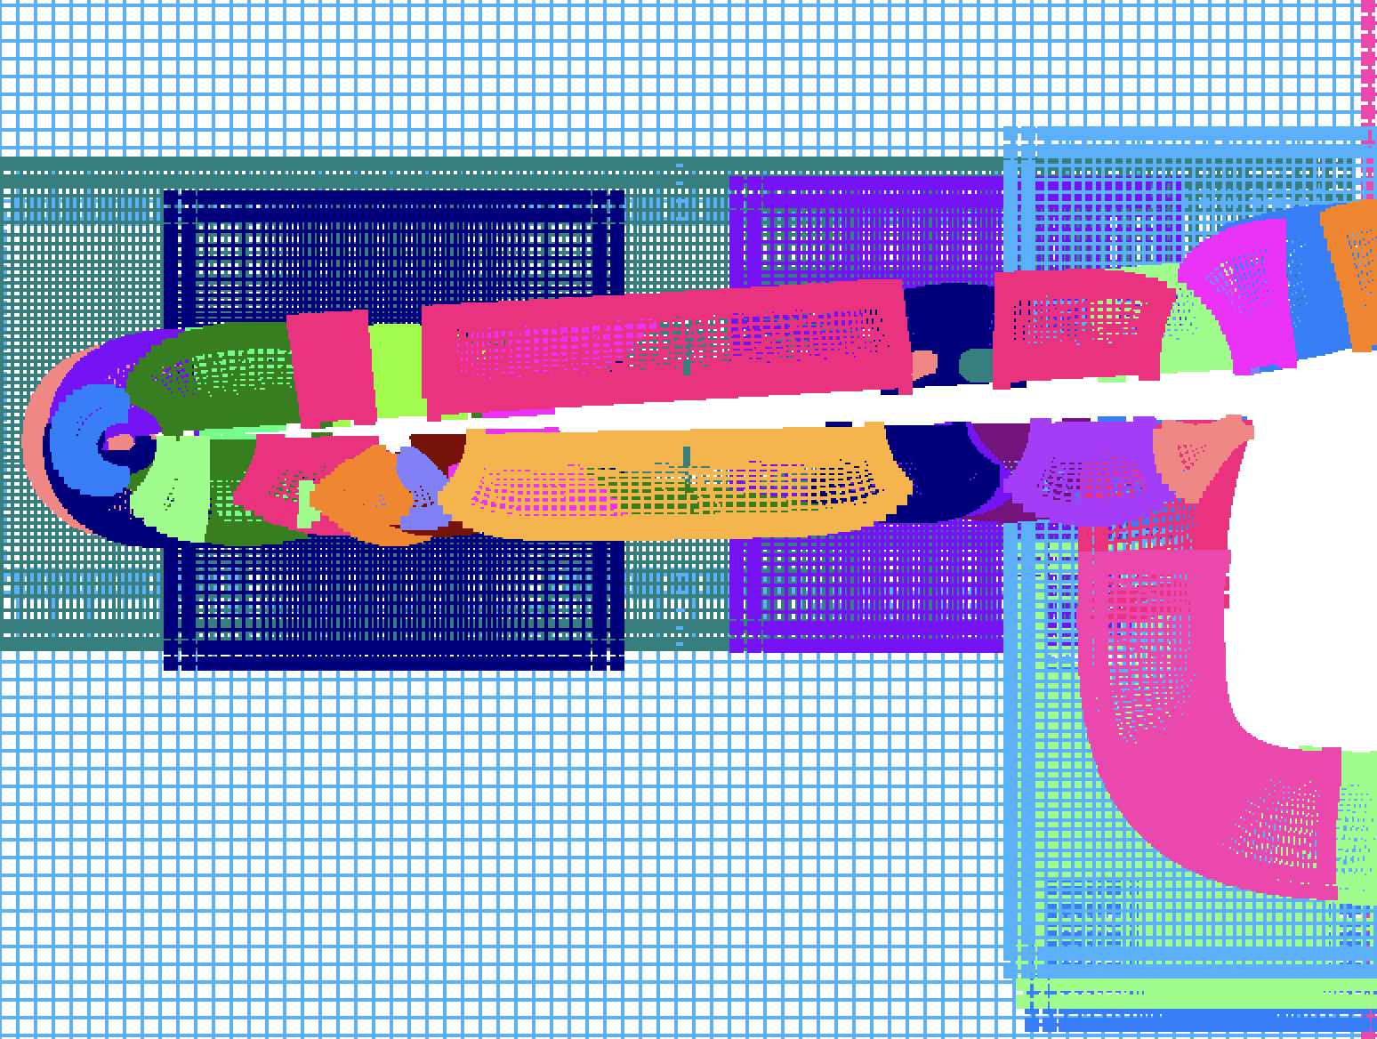
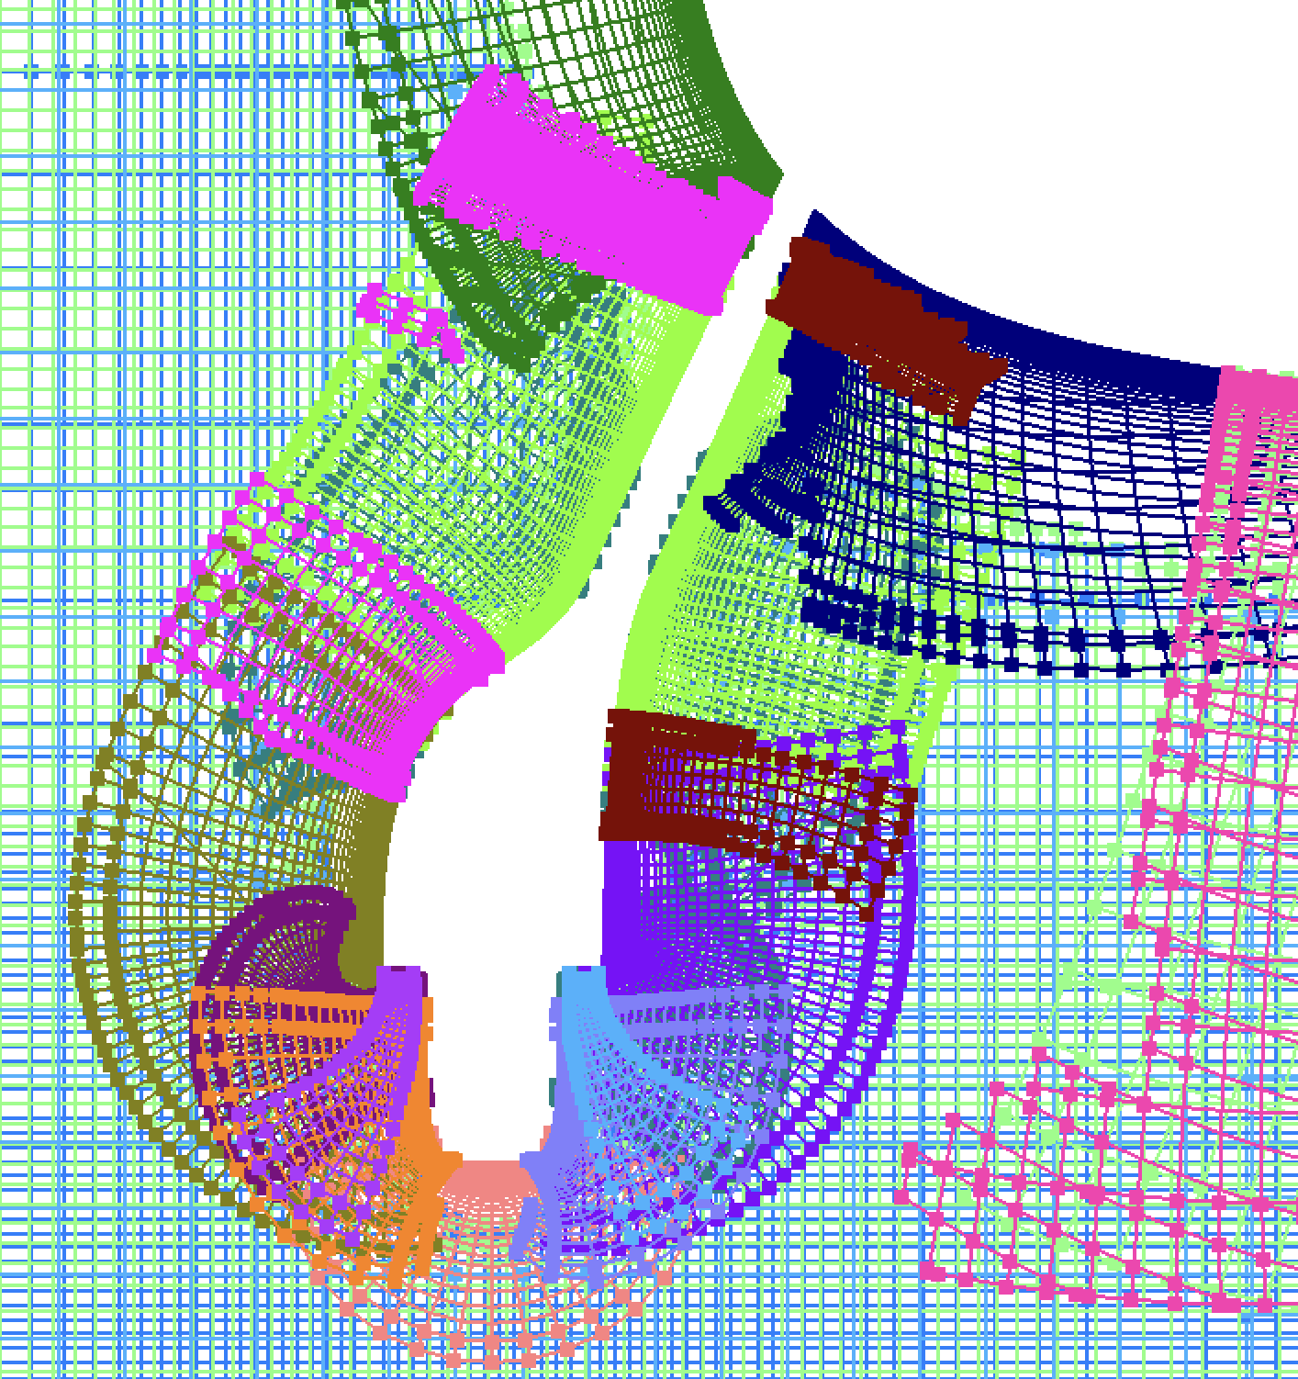
REVIEW OF MESH AUTOMATION SCHEME
BREP Geometry
F = Face
E = Edge
N = Node
Node meshes
Edge meshes
Face meshes
E
F
F
F
N
<
# Meshes #F + #E + #N
~
Surface mesh system
Near-body volume meshes
Domain connectivity data
Near- & off-body volume meshes

Slide 5
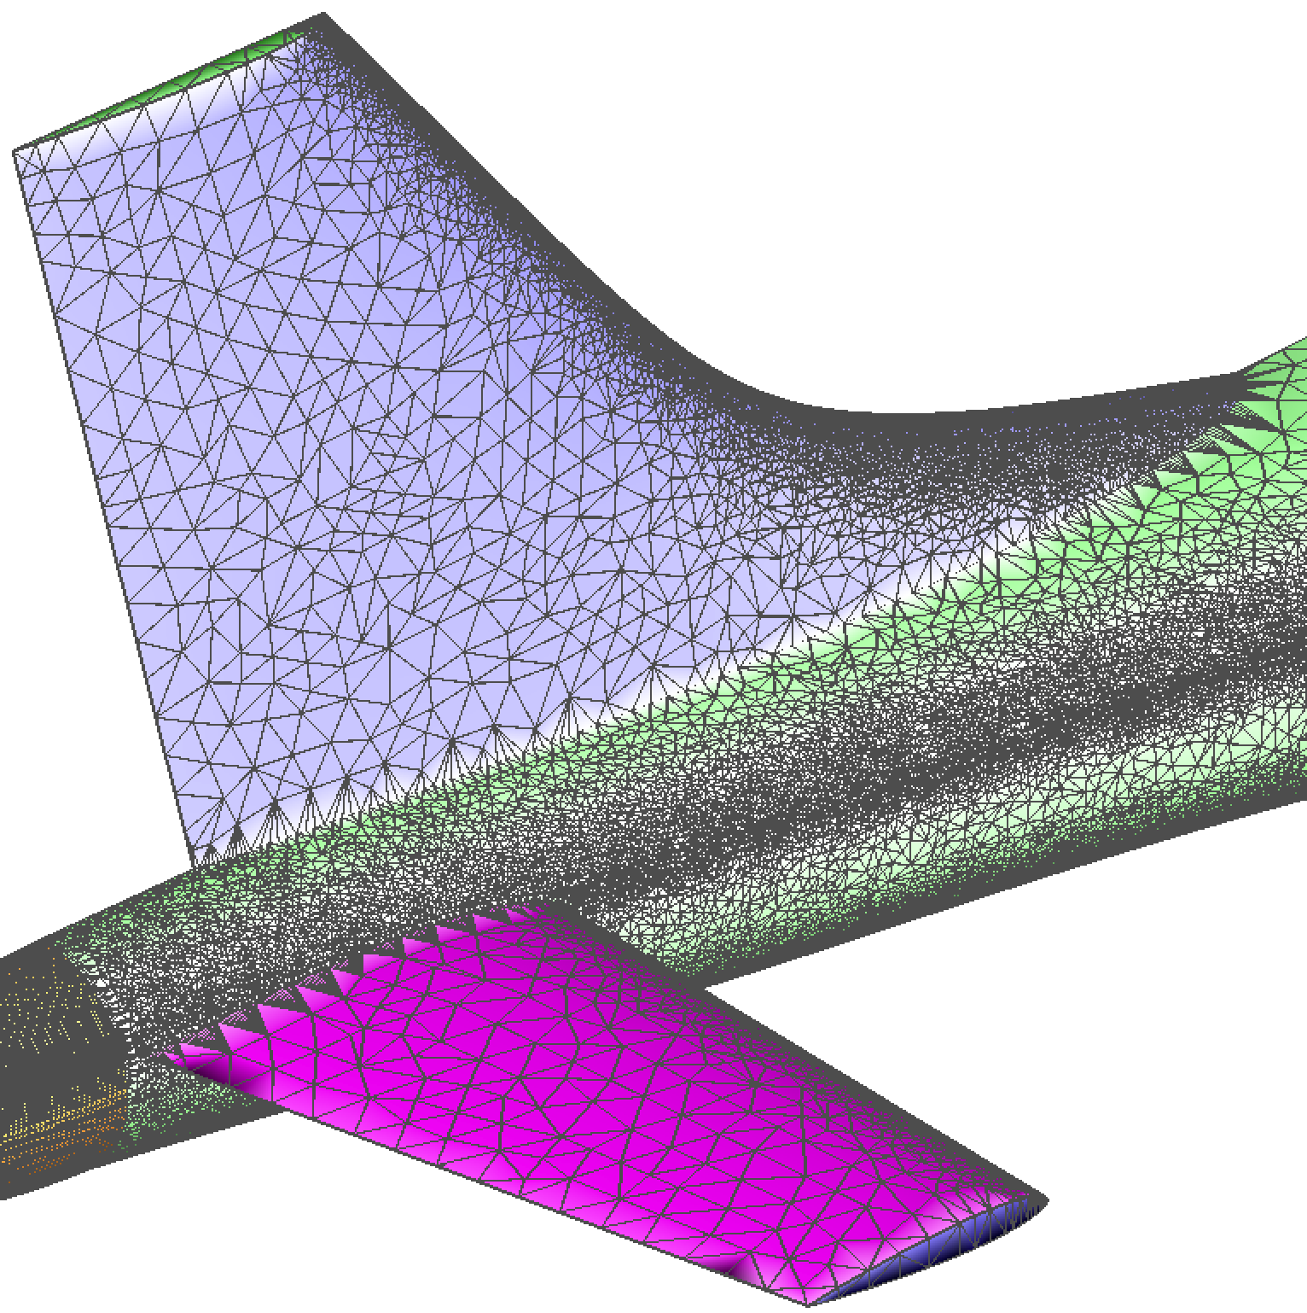
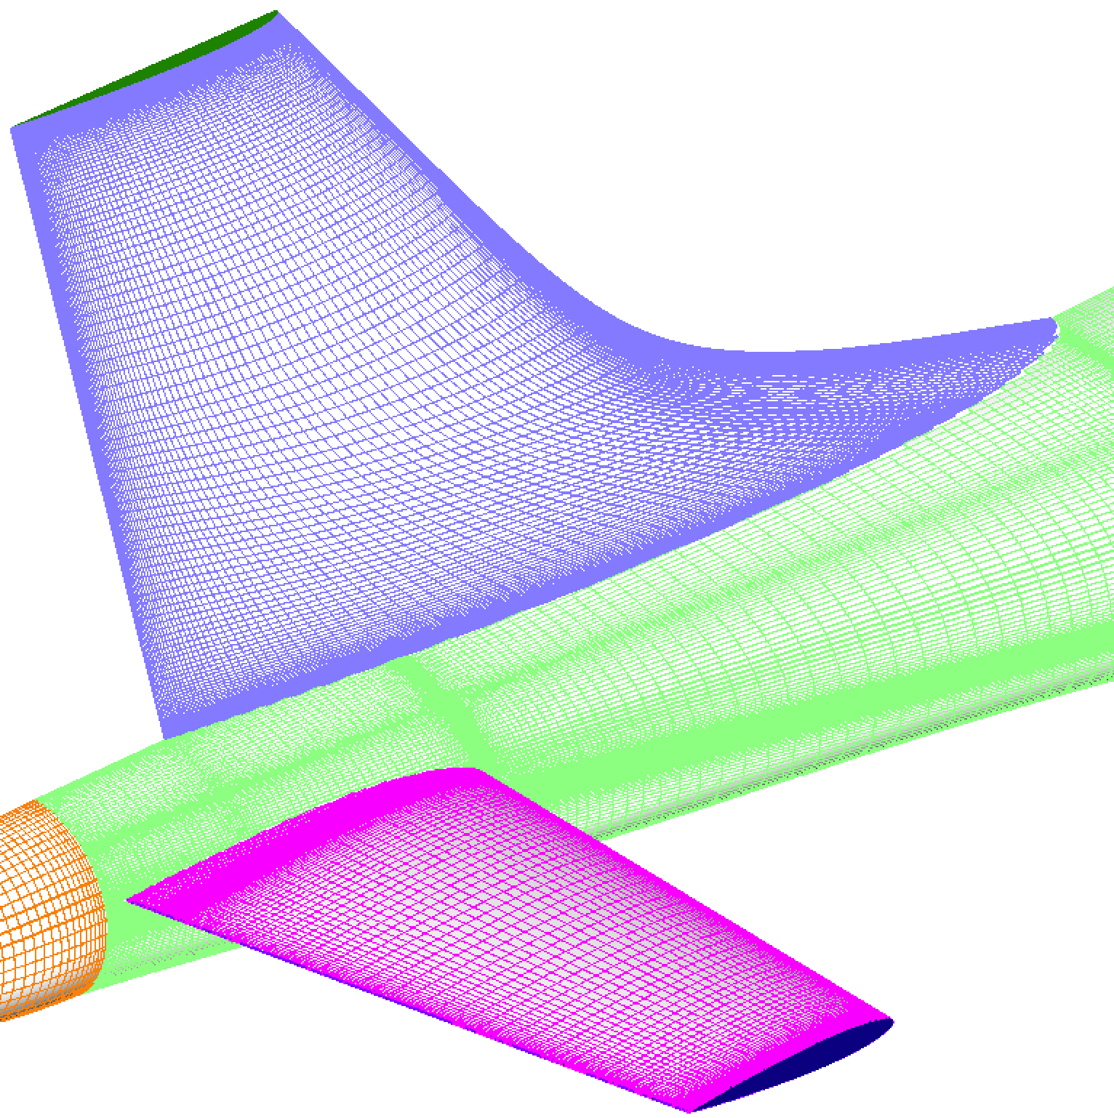
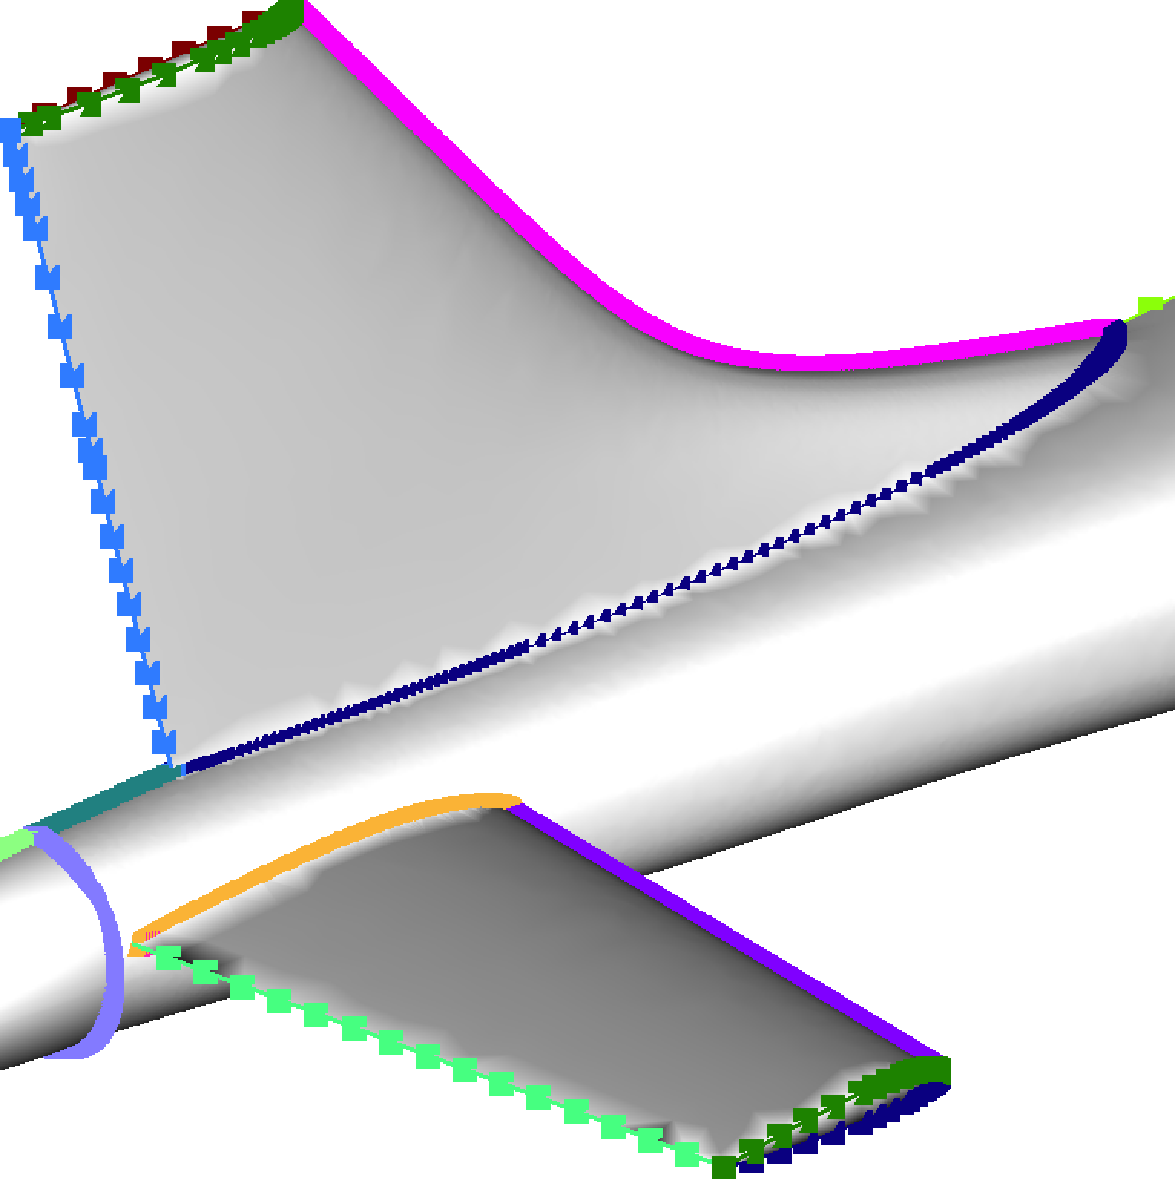
EPOGS WORKFLOW
Engineering Sketch Pad Library
BREP Solid or Sheet Body
Starting Point A
EGADS2SRF
Geometric Components Data
List of faces in each component
Surface Triangulation (trimmed)
Discretized Faces (untrimmed with iblanks, or trimmed without iblanks)
POGS Input File
Topology Data
Discretized Edges
Starting Point B
F_{A} | E_{i} | F_{B}
POGS
Pre-processor for Overset Grid Simulations
Surface Grids
Volume Grids
Mesh Repairs (if needed)
Domain Connectivity Data
Mesh overlap
Negative Jacobians
Input Files for Flow Solvers
Input File for Component Aerodynamic Loads Computation

Slide 6
STARTING POINT B
Discrete Surfaces & Curves, Edge/Face Topology
Surface Triangulation (trimmed)
Discretized Faces (untrimmed with iblanks, or trimmed without iblanks)
Geometric Components Data
POGS Input File
Topology Data
Discretized Edges
.i.tri
.uvin
.pogs.i
.topo
.cur
.gcomp
F_{A} | E_{i} | F_{B}
Global parameter inputs
Max grid spacing
Max stretching ratio
Min grid dimension
Wall normal spacing
# Fringe layers
Min donor stencil quality
Options
(1) Output from OpenVSP
(2) Manual construction using various tools
(3) Surface triangulation with triangles tagged by face ID (work in progress)

Slide 7
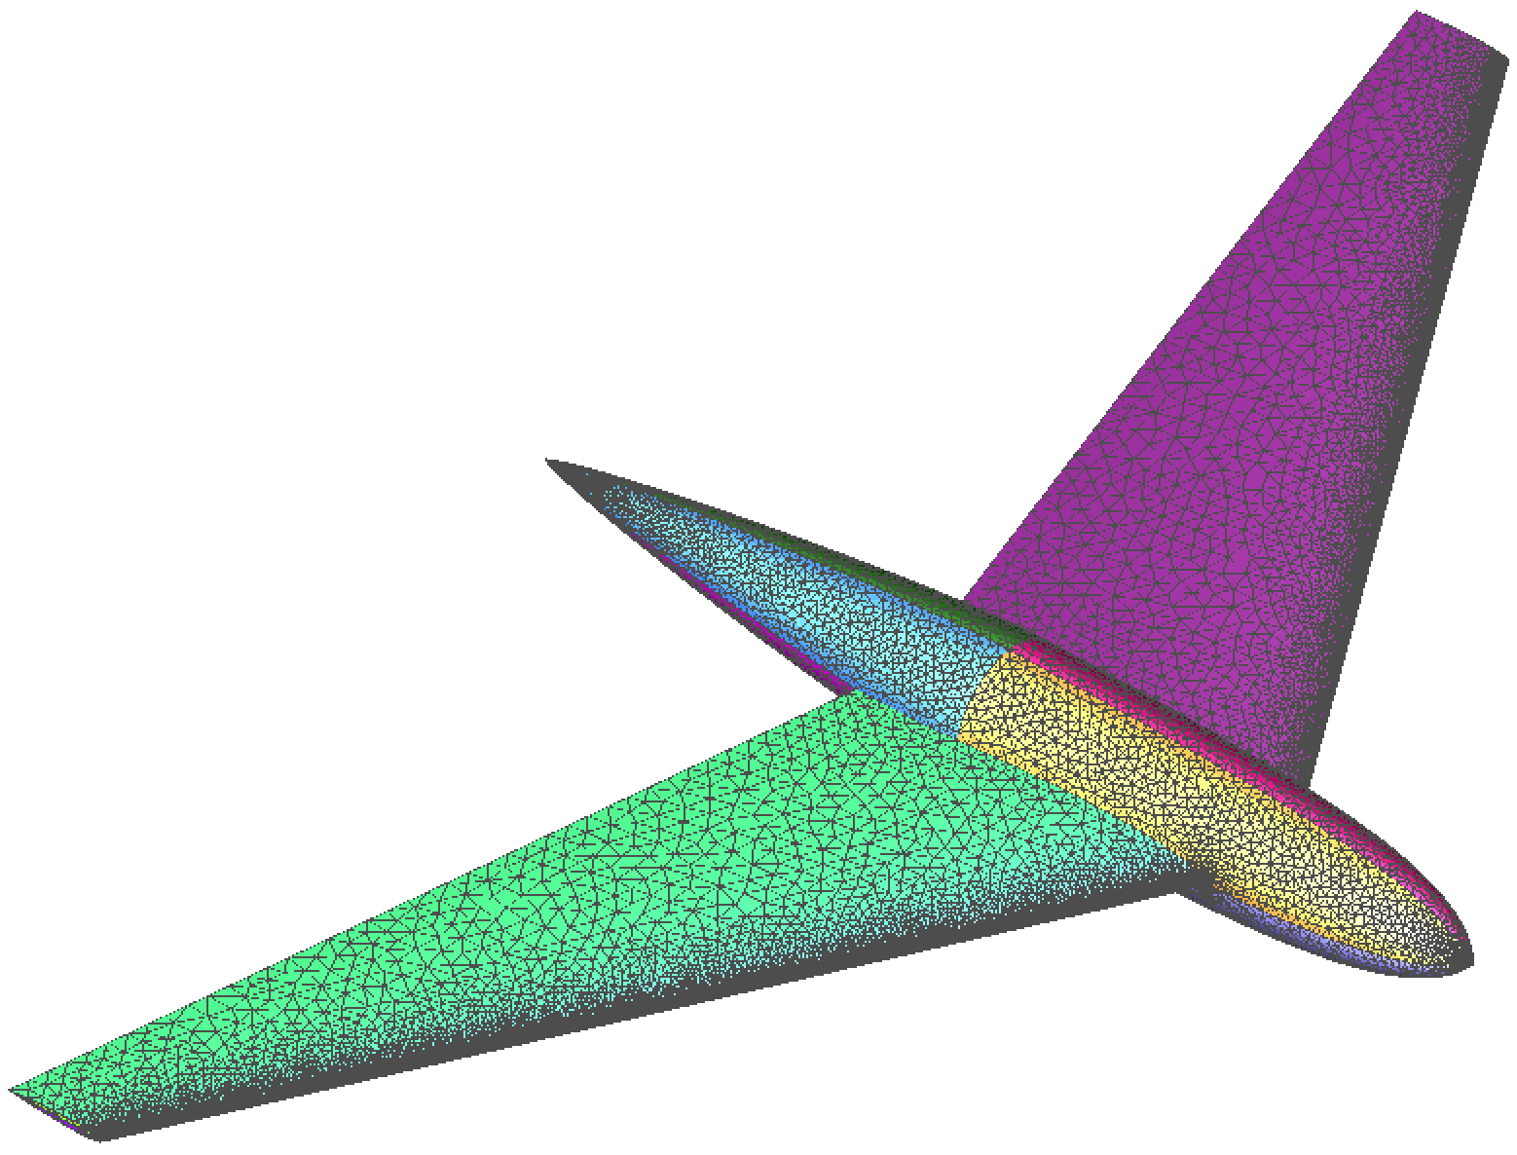
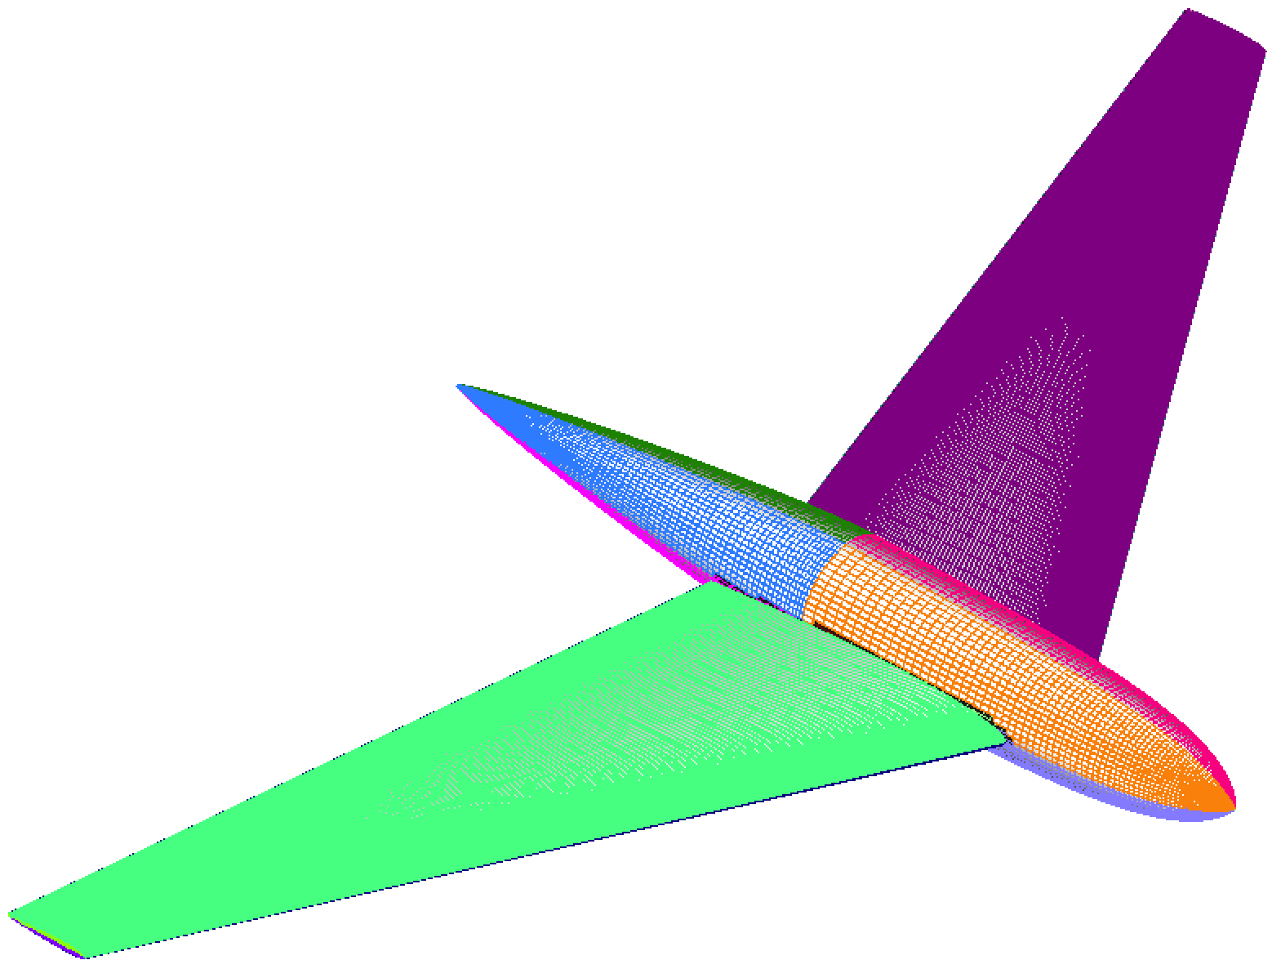
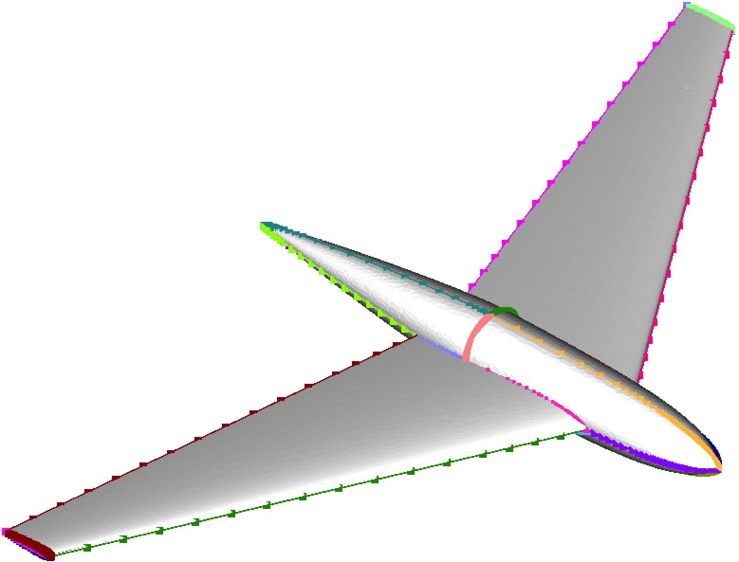
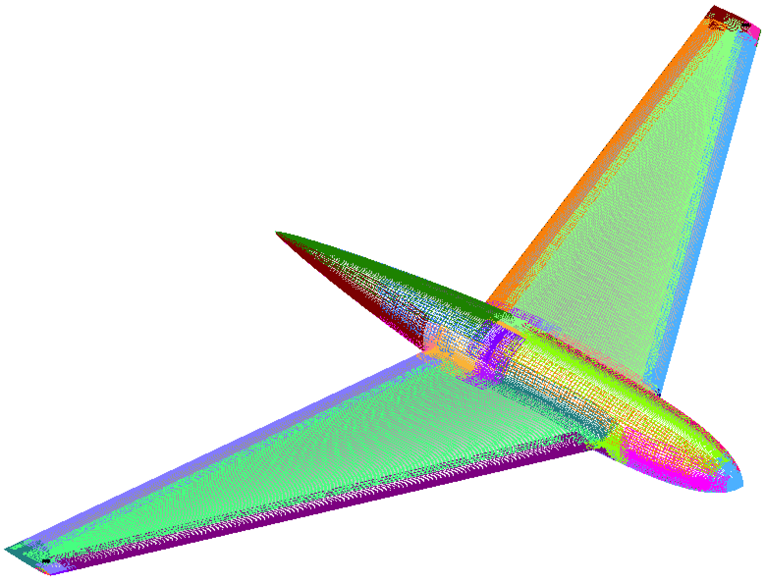
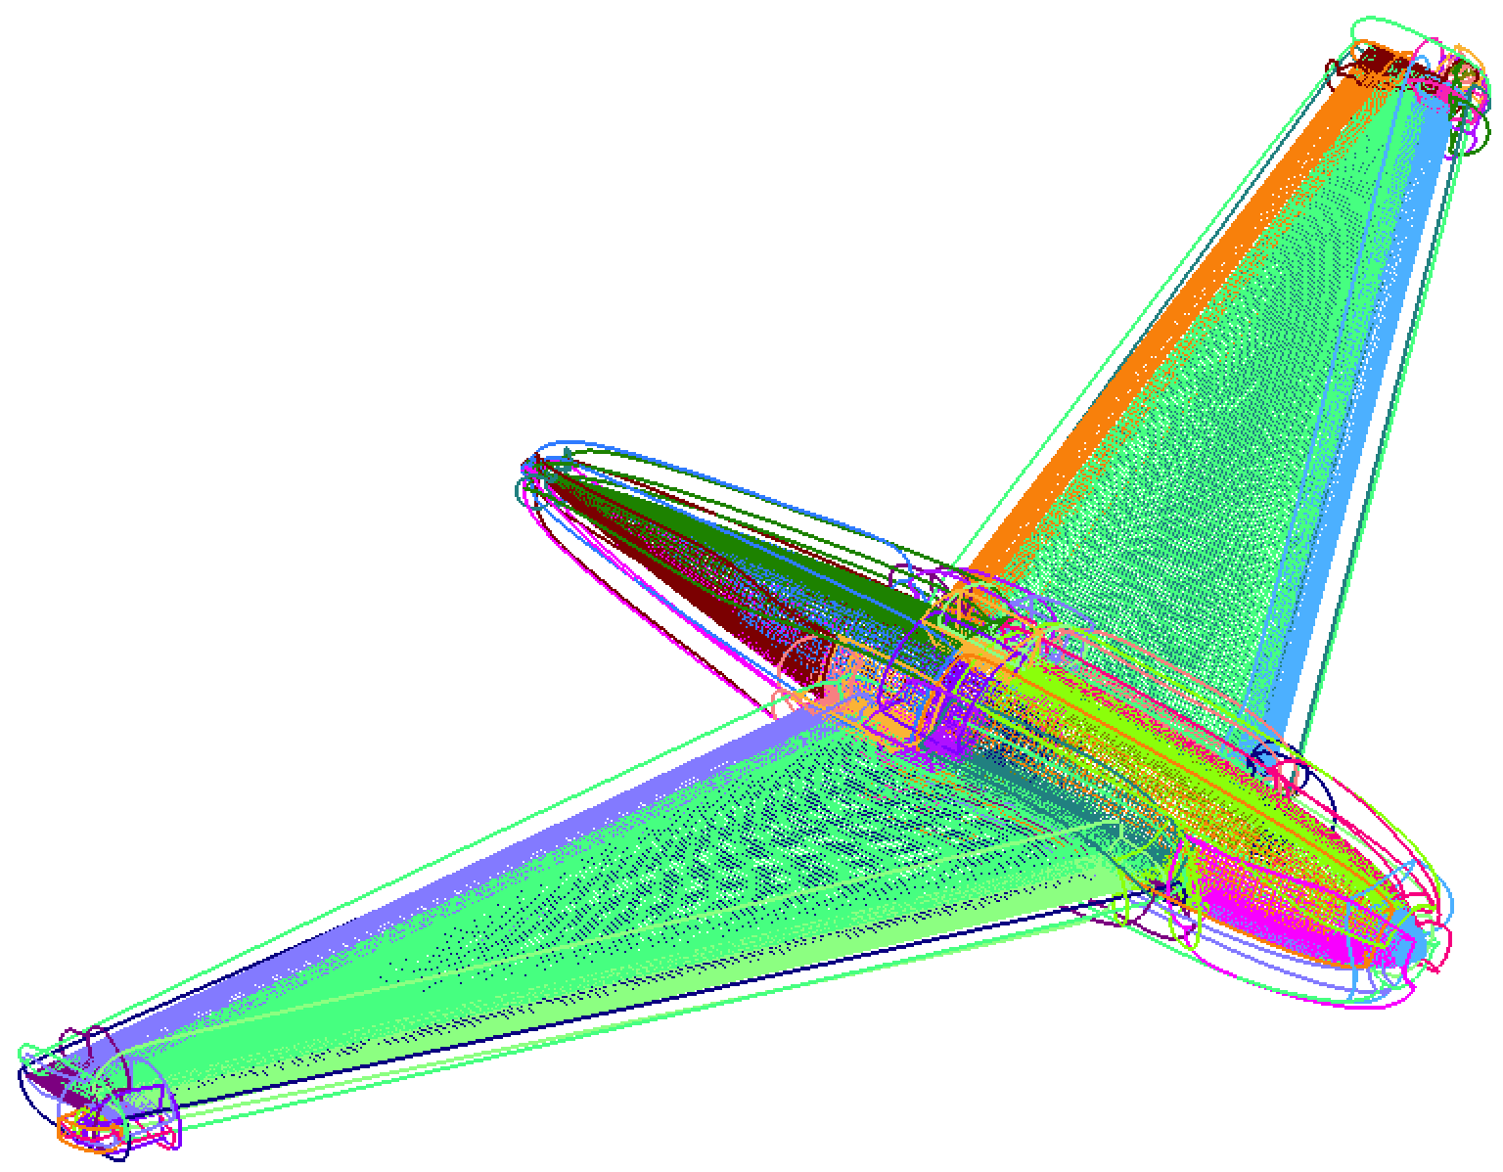
STARTING POINT B – OpenVSP
Podwing
Edge/Face Topology (.topo)
Geometric components (.gcomp)
POGS input (.pogs.i)
.i.tri
.uvin
.cur
# Near-body grid pts = 6.8M
No Negative Jacobians
# Surface grids = 62
Total run time
Surface + volume = 18s
Mac M2 laptop

Slide 8
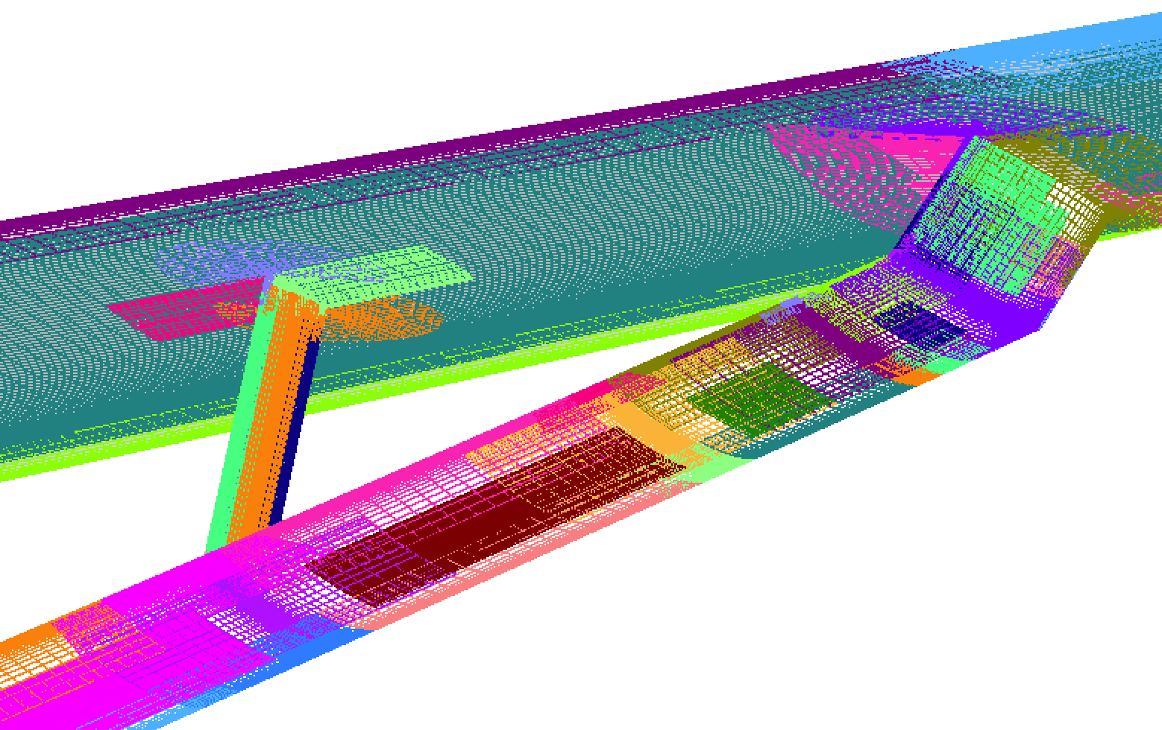
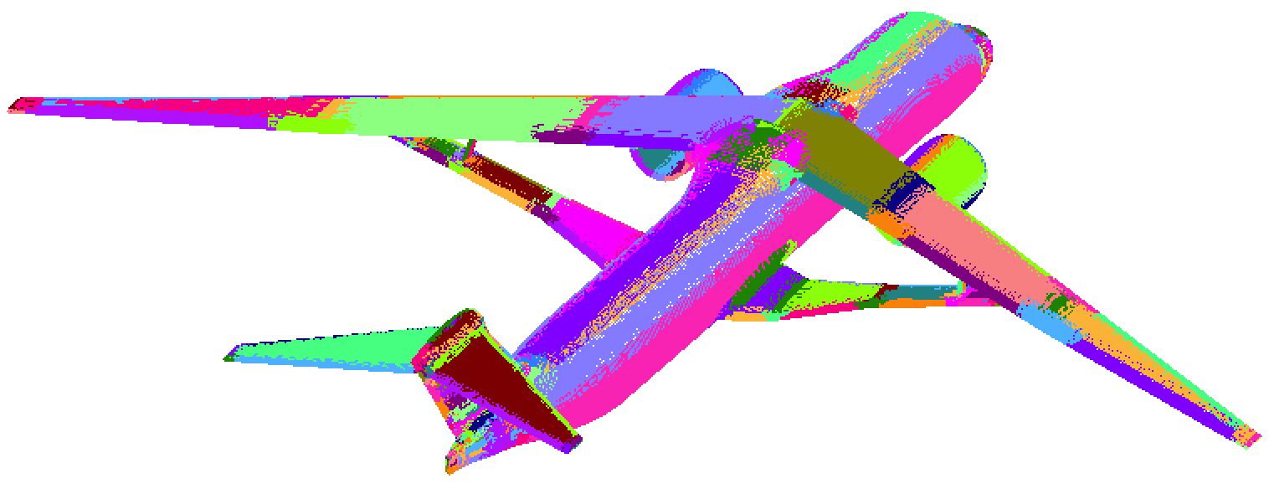
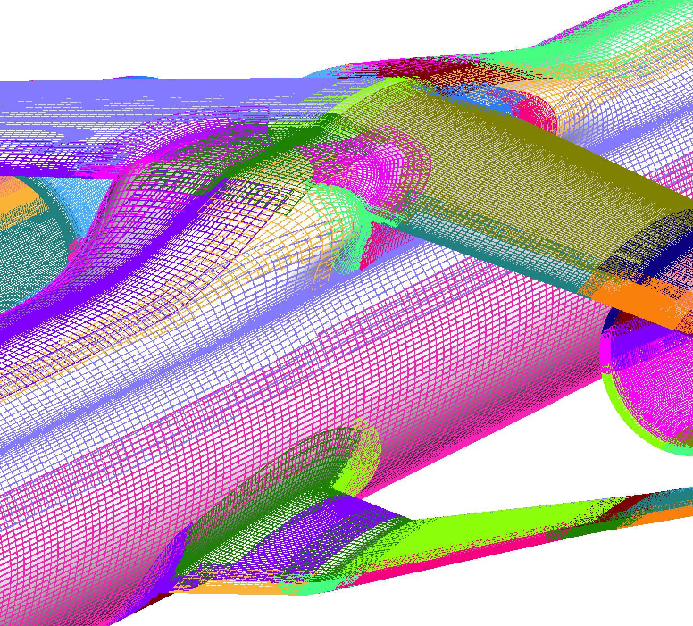
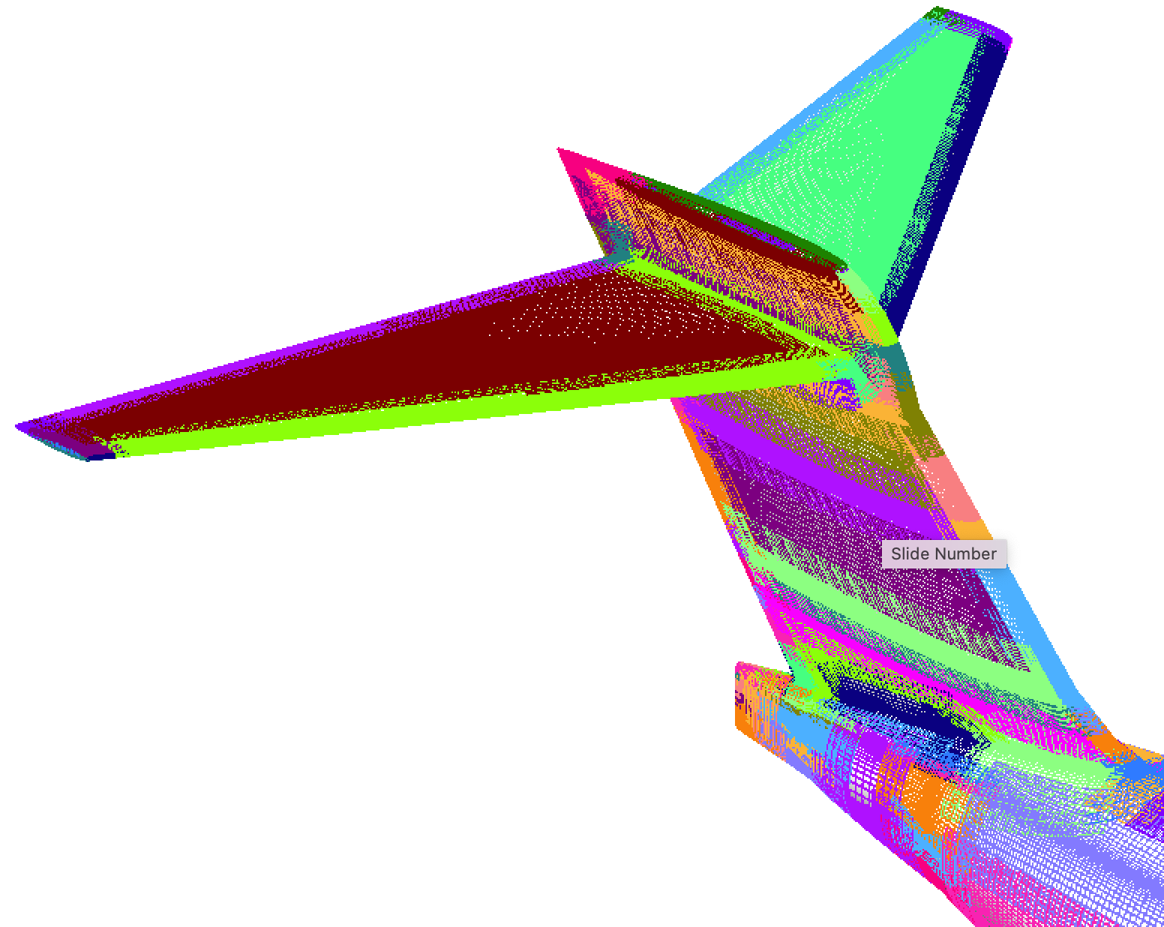
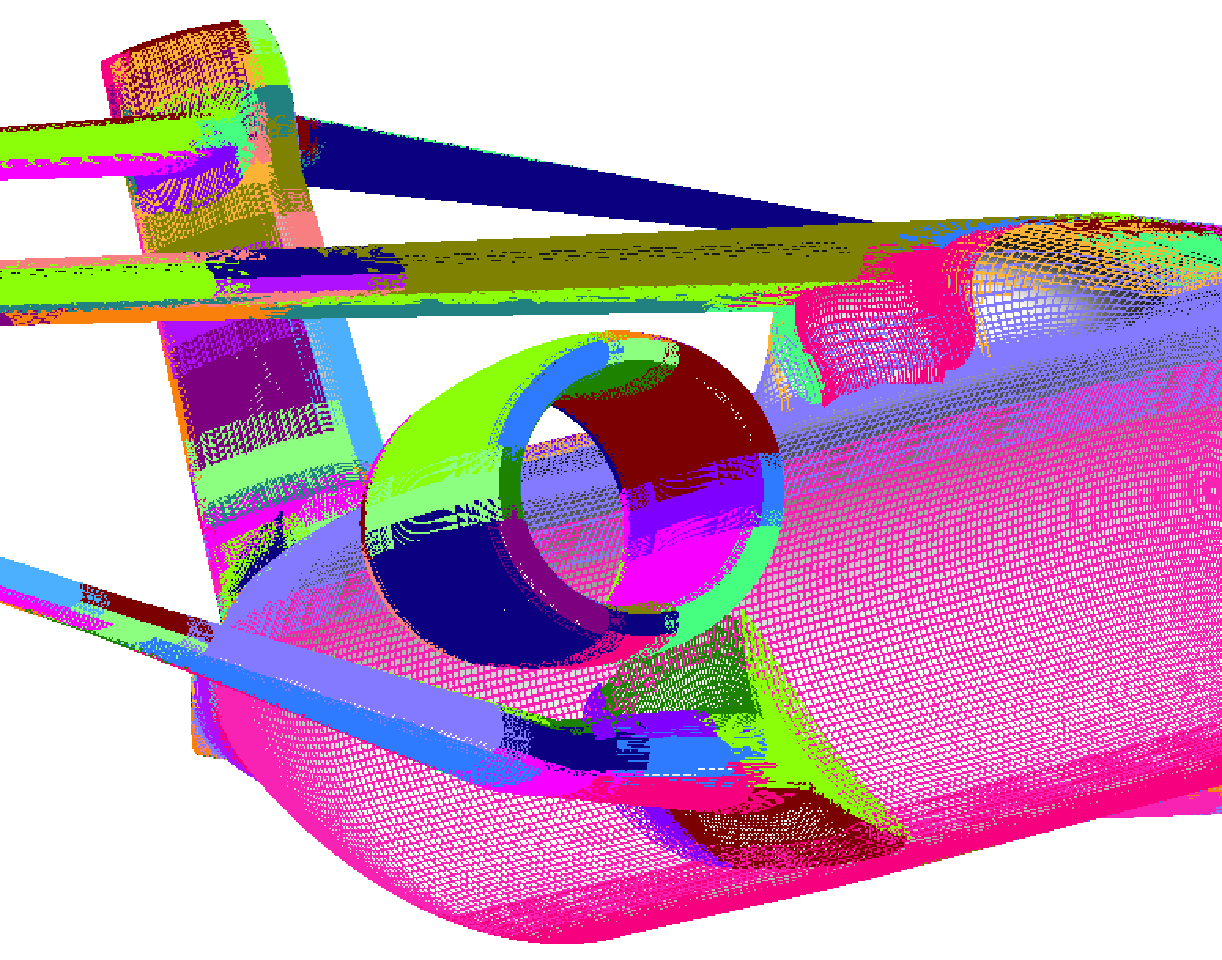
STARTING POINT B – OpenVSP
Generic Strut Braced Wing
# Grids = 464
# Surface pts ~ 1.2M
# Orphan pts ~ 1500
Run time ~ 1 min 8 sec
# Volume pts ~ 74M
# Defective volume grids = 15
Run time ~ 1 min 40 sec
Notes:
Much easier to start with clean geometry input

Slide 9
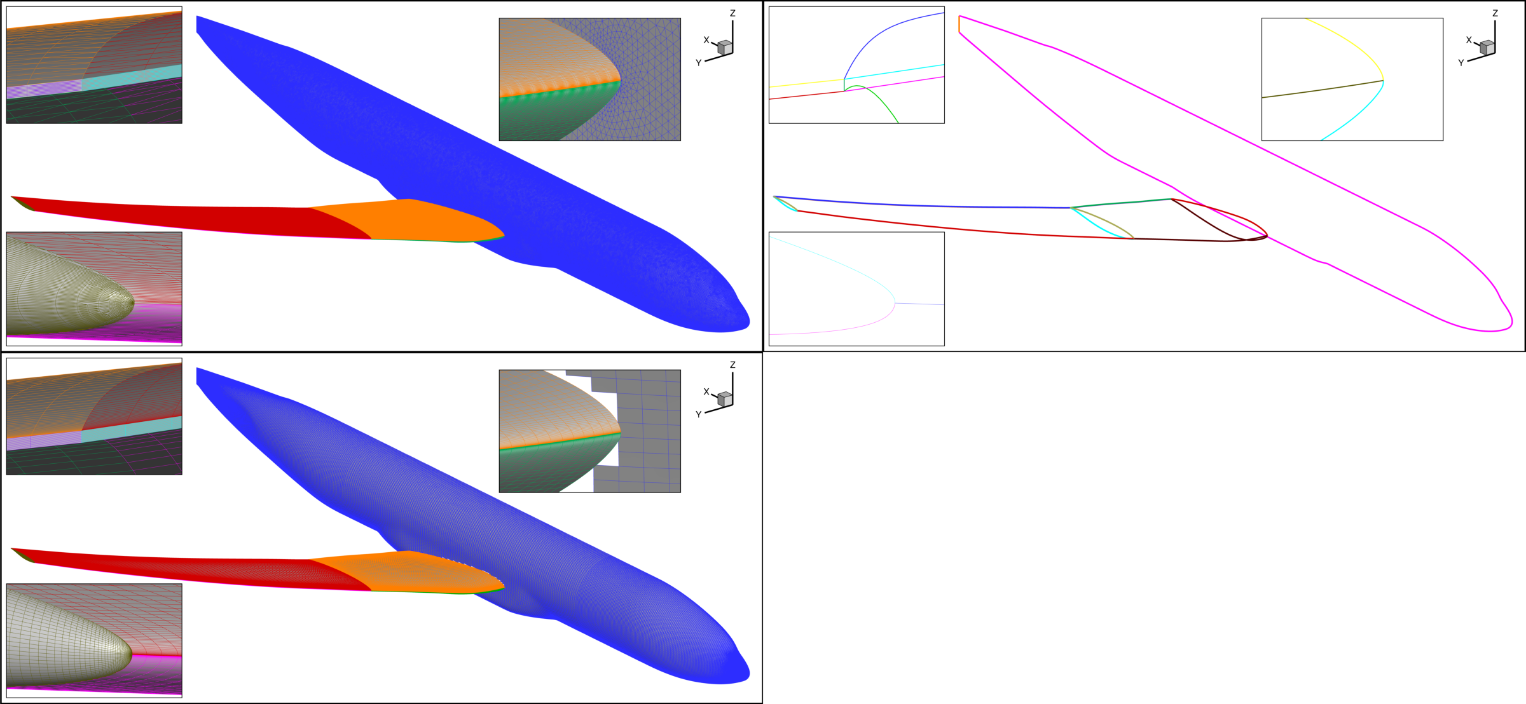
STARTING POINT B – External Tools
CRM-NLF (Natural Laminar Flow Wing)
Surface triangulation with face IDs (ANSA STL)
Plot3D curves at boundaries of trimmed faces (CGT/SEAMCRT + minor mods in OVERGRID)
Jeff Housman
Starting geometry: Sheet or face body
Discrete inputs to POGS generated manually (~ 1 hr )
Topology (python script topogenerator.py)
Plot3D surfaces (Pointwise) with iblanks (LAVA utility quadTriProjTrim)

Slide 10
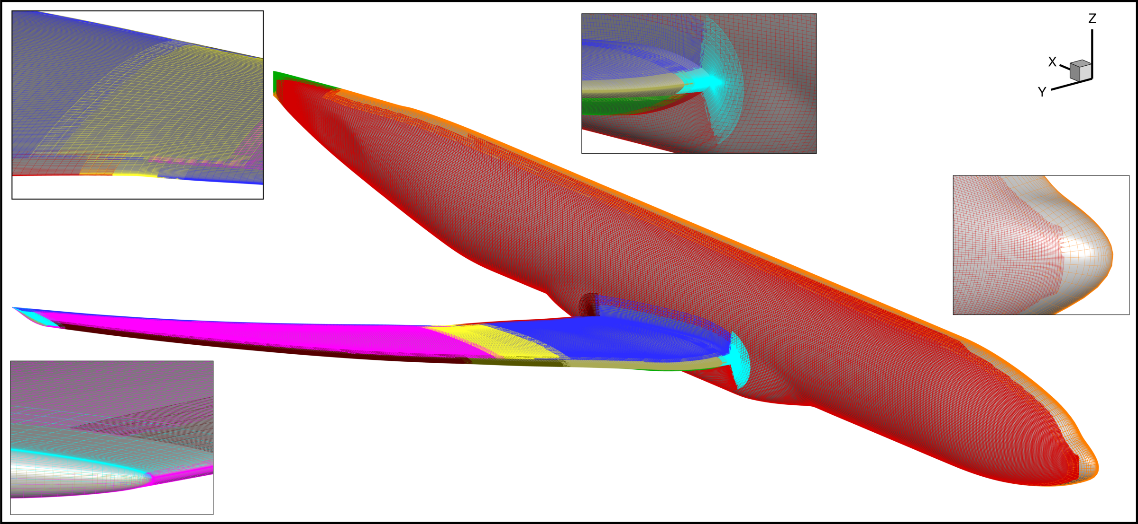
STARTING POINT B – External Tools
POGS Surface Grids for CRM-NLF
  27 near-body surface grids
  250K surface grid points
  20 orphans (DQUAL 0.5)
  Run time ~ 1 min on M2 Mac laptop

Slide 11
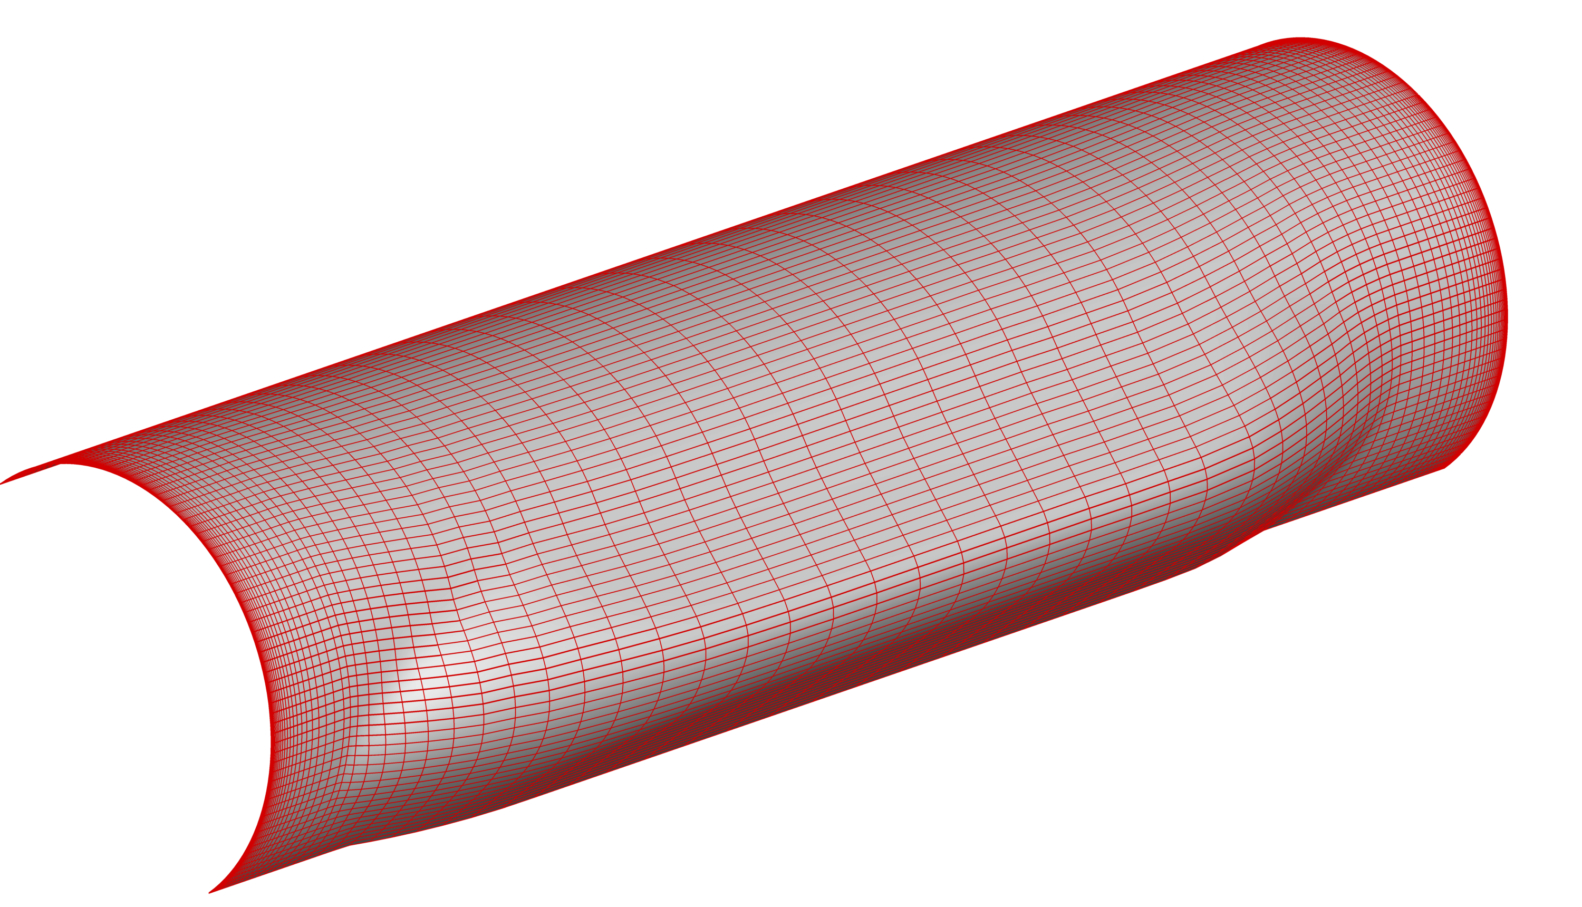
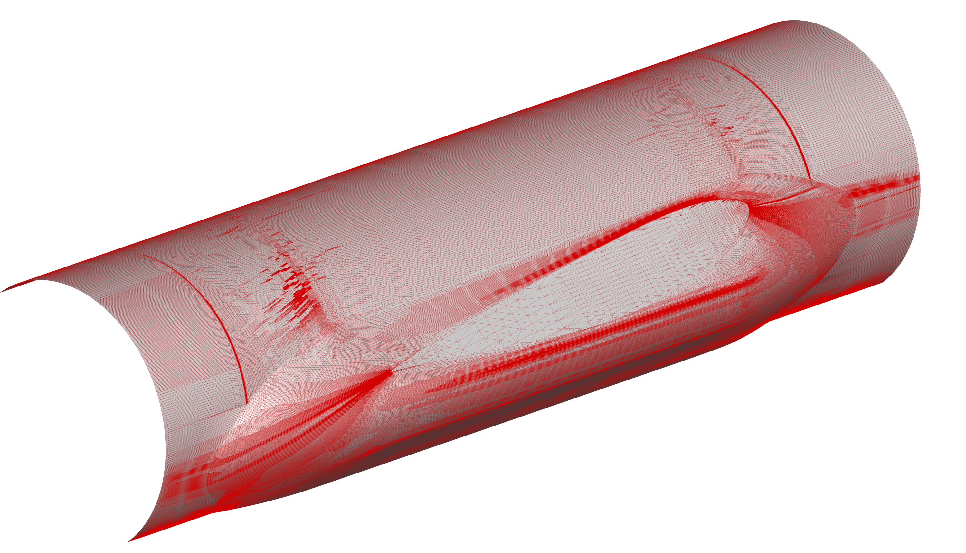
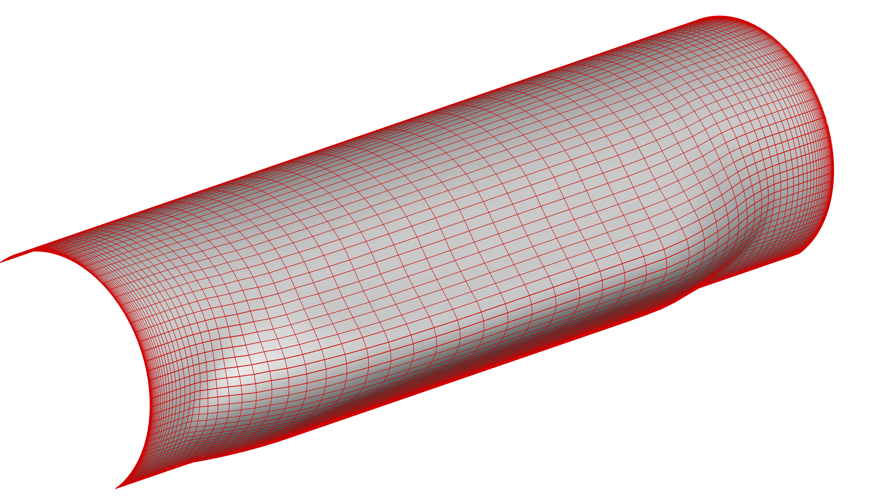
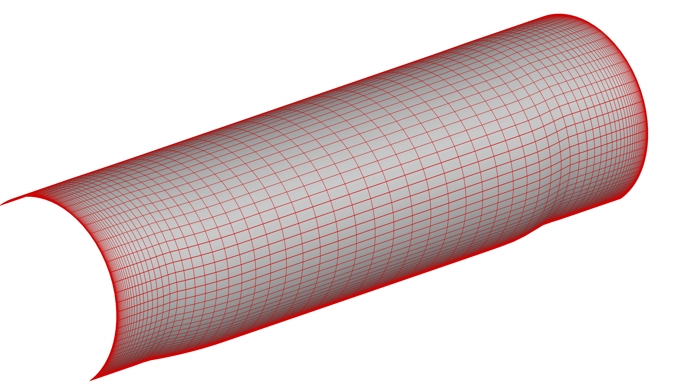
STARTING POINT B – Surface Triangulation
Chase Ashby
Project and Smooth: 1000 iterations
Input triangulation
Coons Patch
Project and Smooth: 100 iterations
UVs generated for faces with 2, 3, or 4 edges
Transfinite interpolation, surface projection, & smoothing

Slide 12
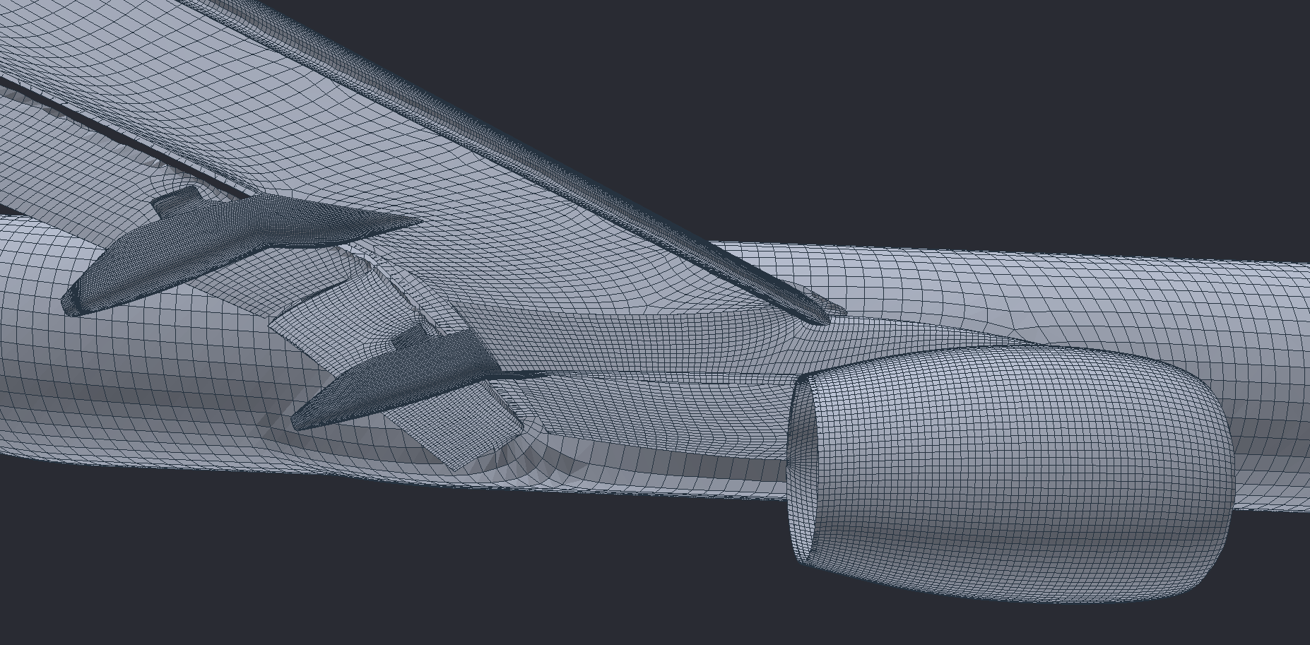
AUTO-QUADDING EXAMPLE USING GEOMETRY PROCESSING LIBRARY libigl
NASA’s High-Lift CRM
Auto-generated quads
Insufficient quality for resolving surface features in high-fidelity CFD computations
Notes:
Automated algorithms exist for generating UVs starting from a surface triangulation (Mixed Integer Quadrangulation)
Here is an example of the poor quality UVs produced by libigl (a software used by companies like Adobe for geometry rendering)
Work is being done to study these methods and improve them for CFD

Slide 13
STARTING POINT B – Surface Triangulation
Quadrangulation Software (work in progress)
Discretized Faces
Surface Triangulation (trimmed)
AUTOQUAD
Discretized Edges
Topology Data
  Starting point: surface triangulation & small set of user configuration options
  Detect edges, corners, & compute local & global topological information
  Decompose into regions bounded by surface features
  Tessellate each region into quads
    2, 3, or 4 edges - TFI interior
    > 4 edges - Mixed Integer Quadrangulation (MIQ) solver
  Explore constrained quandrangulation methods
    maximize fidelity
    minimize quad face count

Slide 14
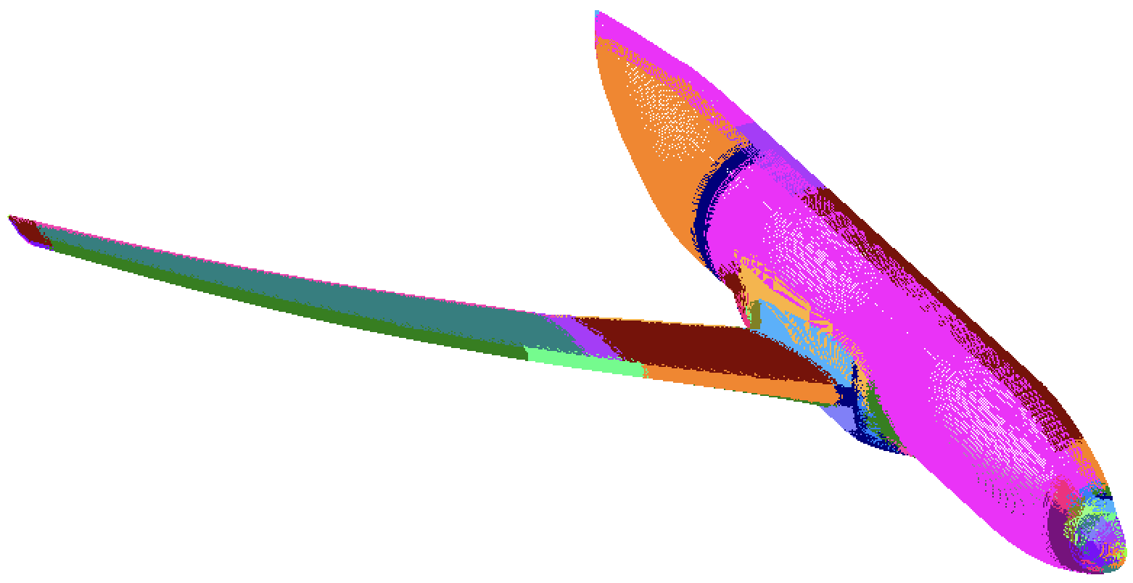
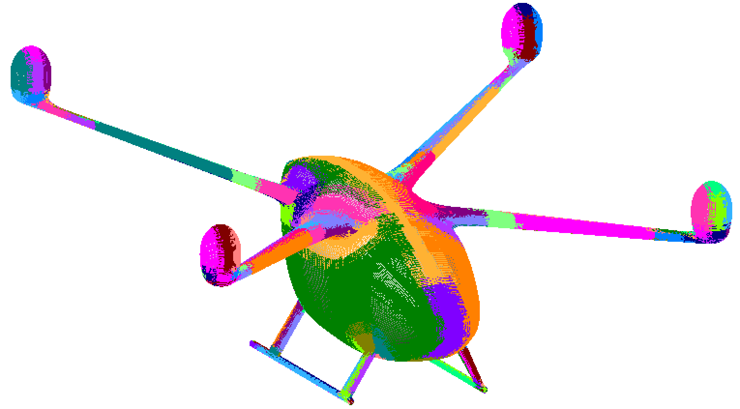
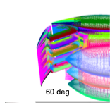
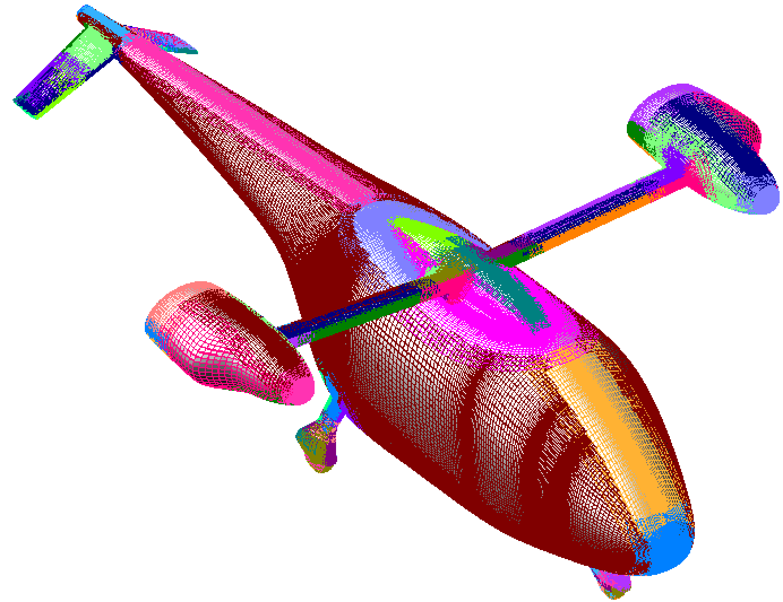
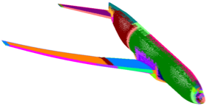
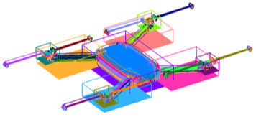
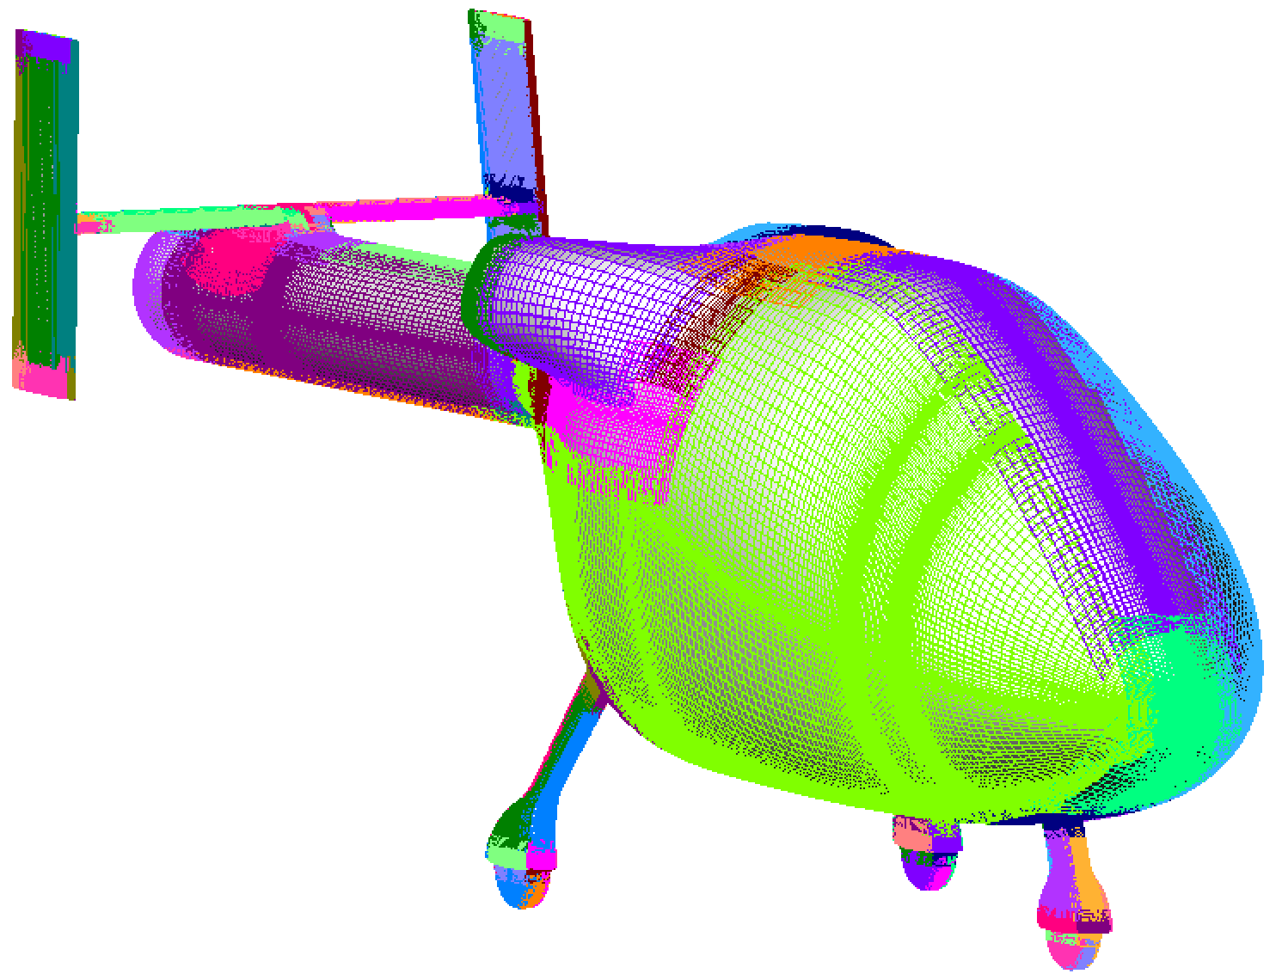
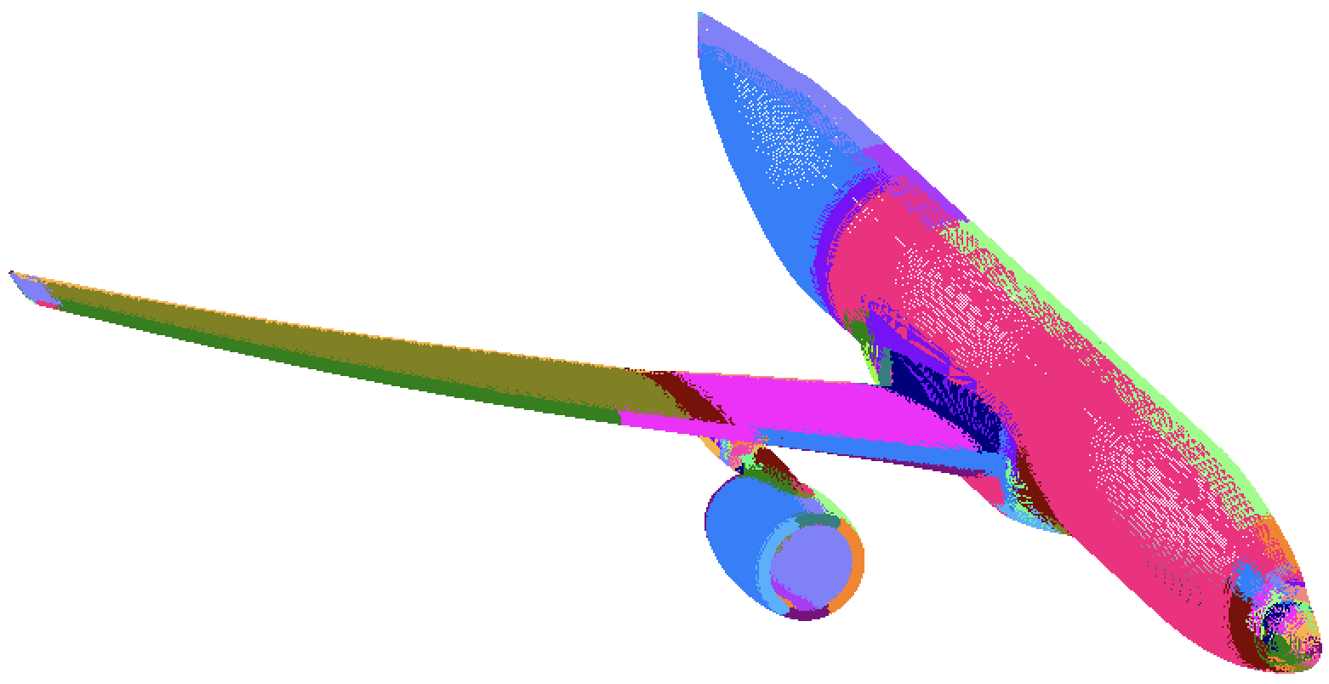
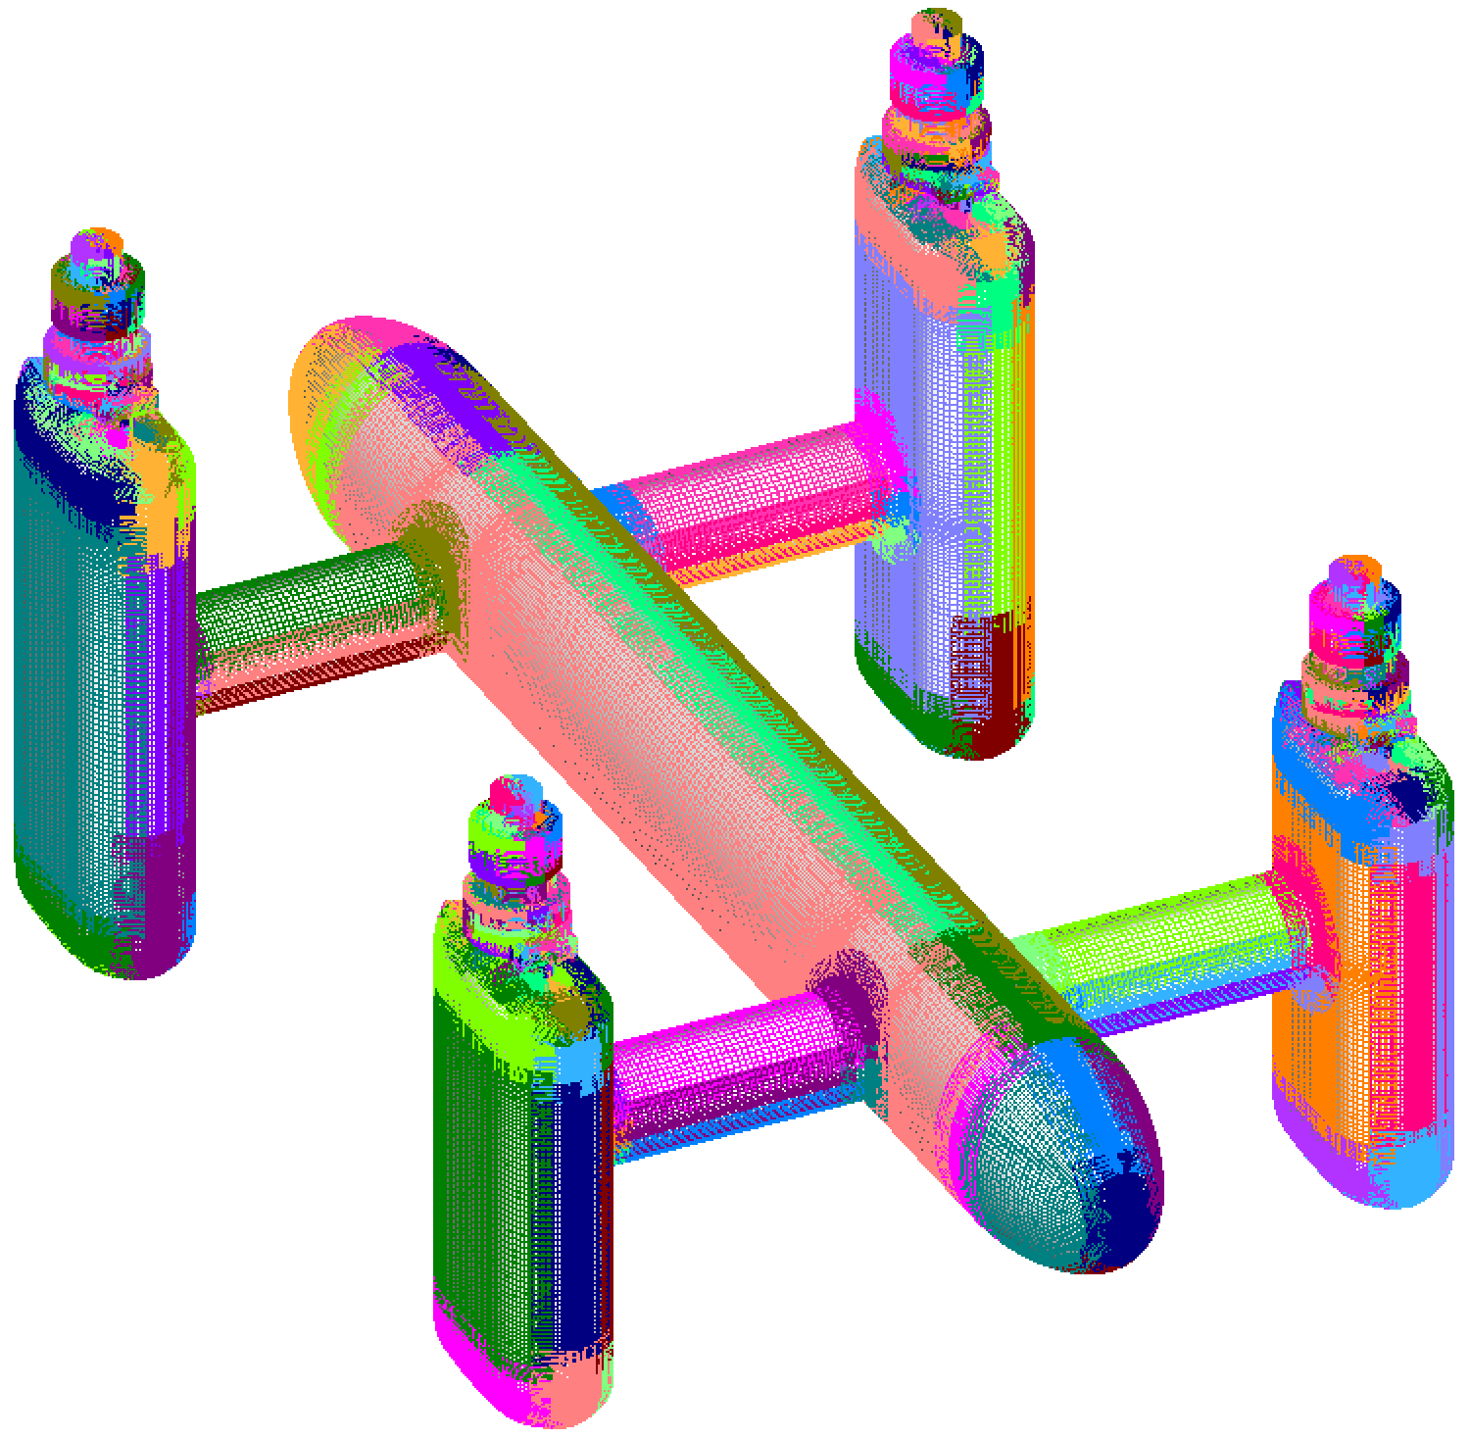
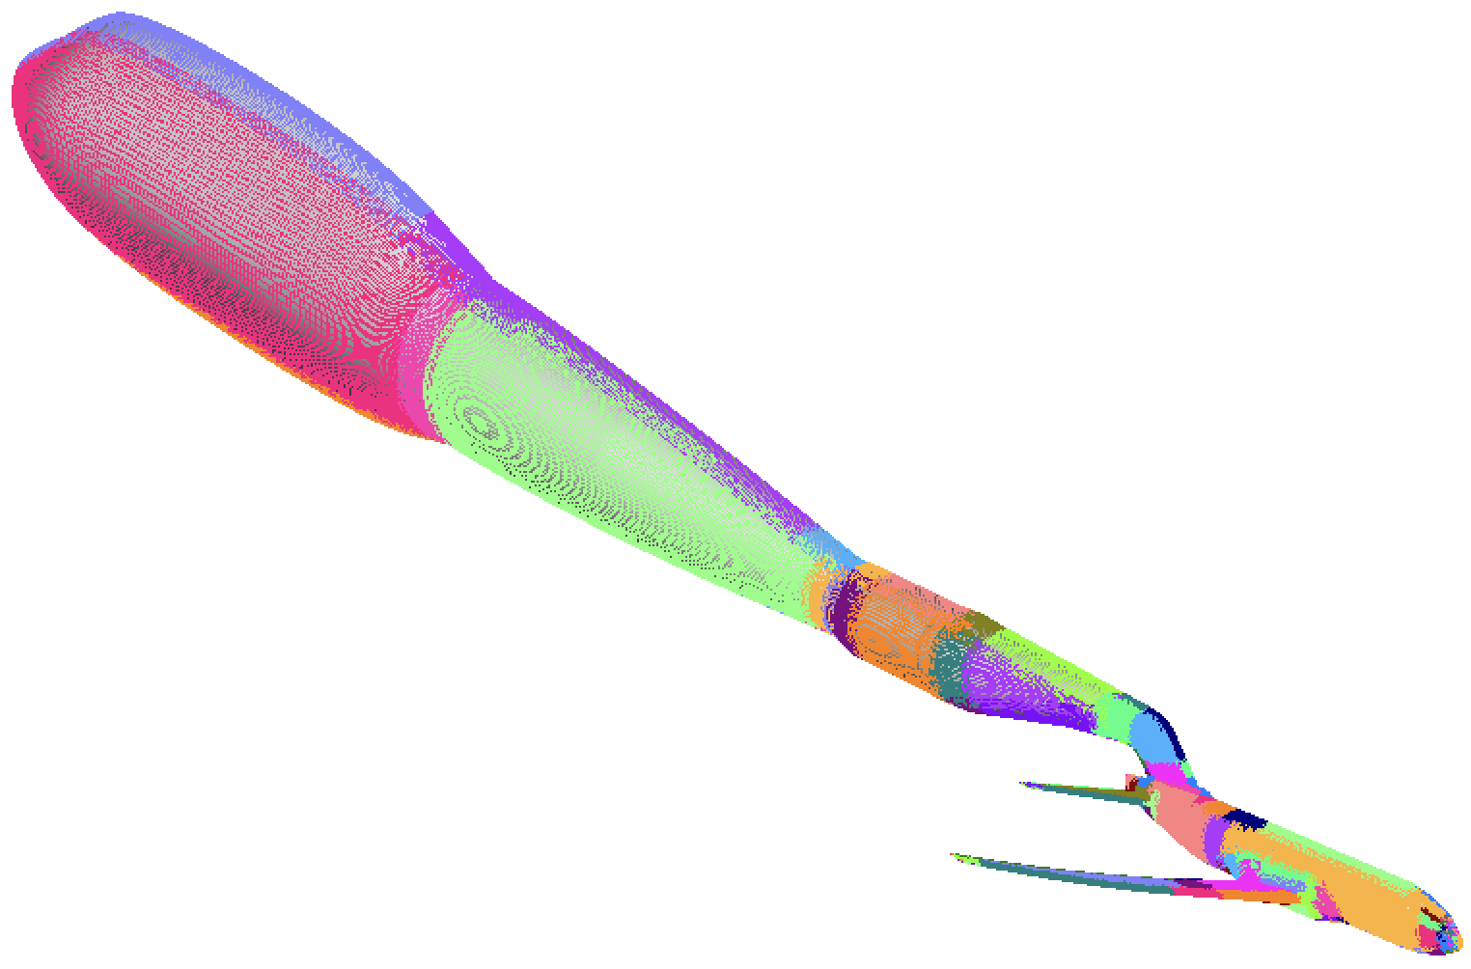
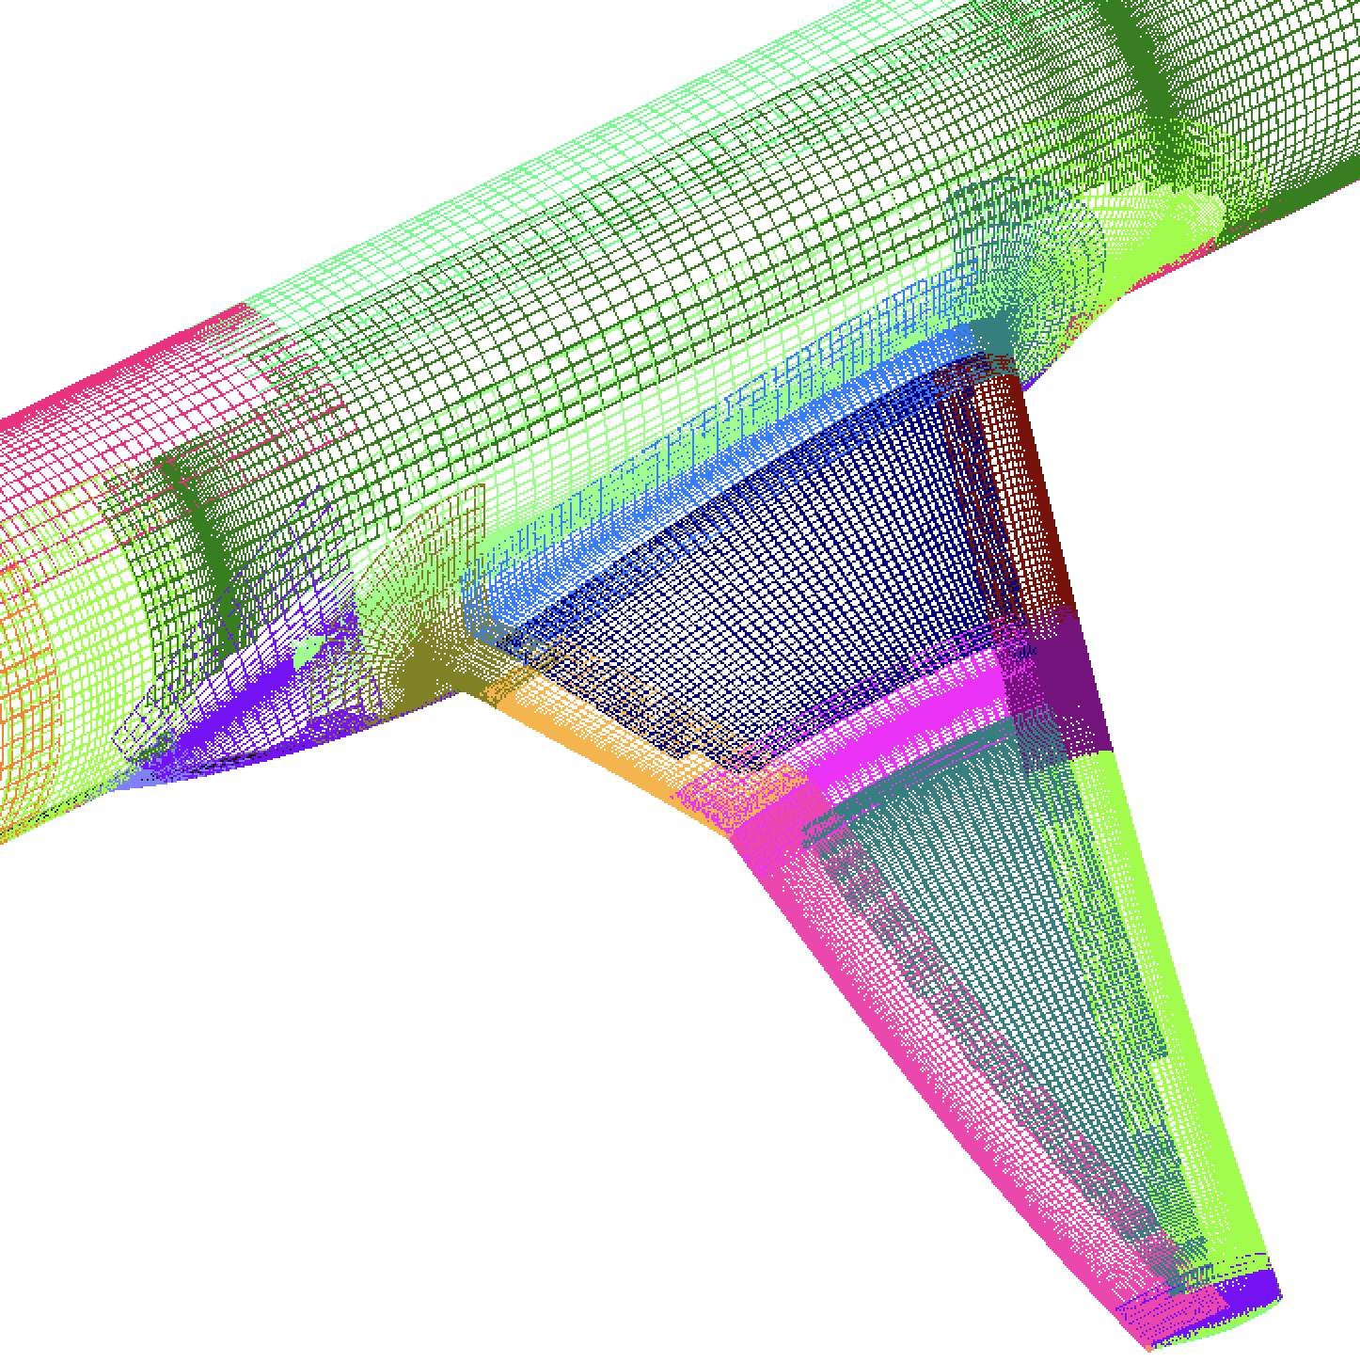
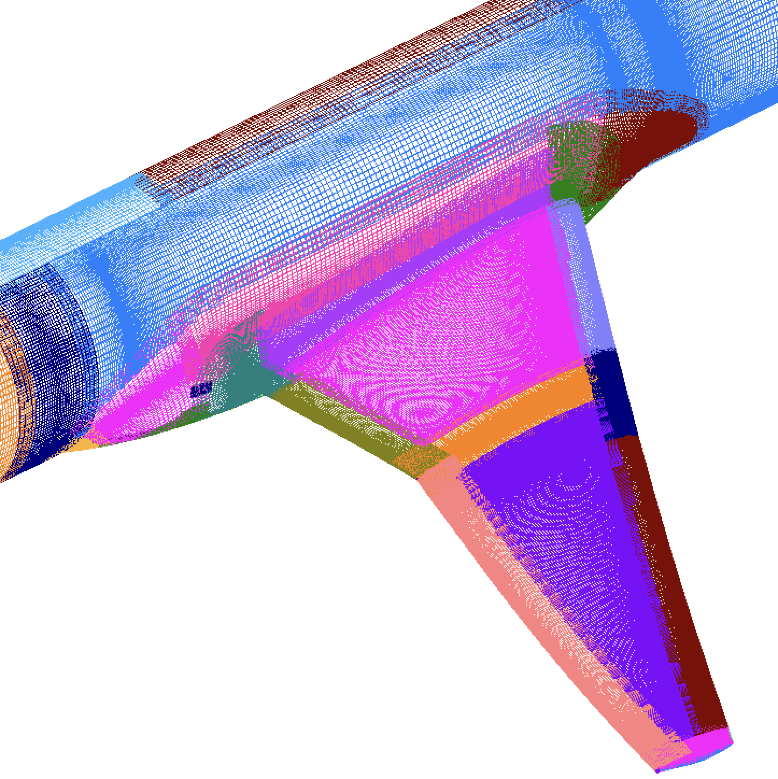
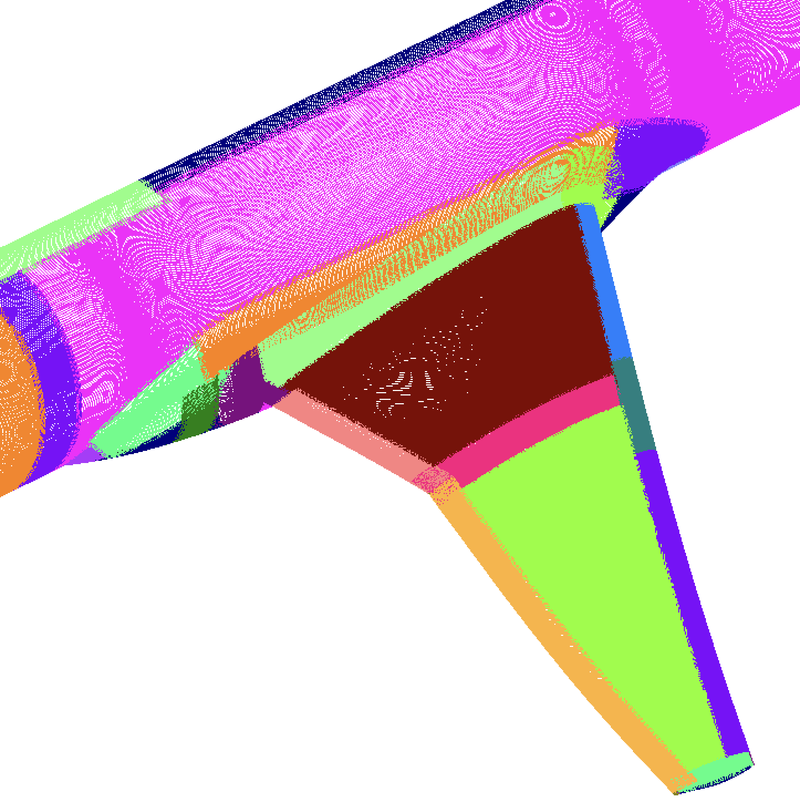
TEST CASES (2020 – 2026)
AIAA Drag Prediction Workshop 8
15 Configurations
40 Grid systems
6 level mesh families
Geometric variation
Mesh parameter variation
Wind Tunnel Tests
& Hardware
eVTOL Concept Vehicles
AIAA Paper 2025-3384
Tiltwing Test Rig
AIAA Paper 2026-4121
Test Environment Sting On/Off Study
Multi-Rotor Testbed 3
L1
L3
L6

Slide 15
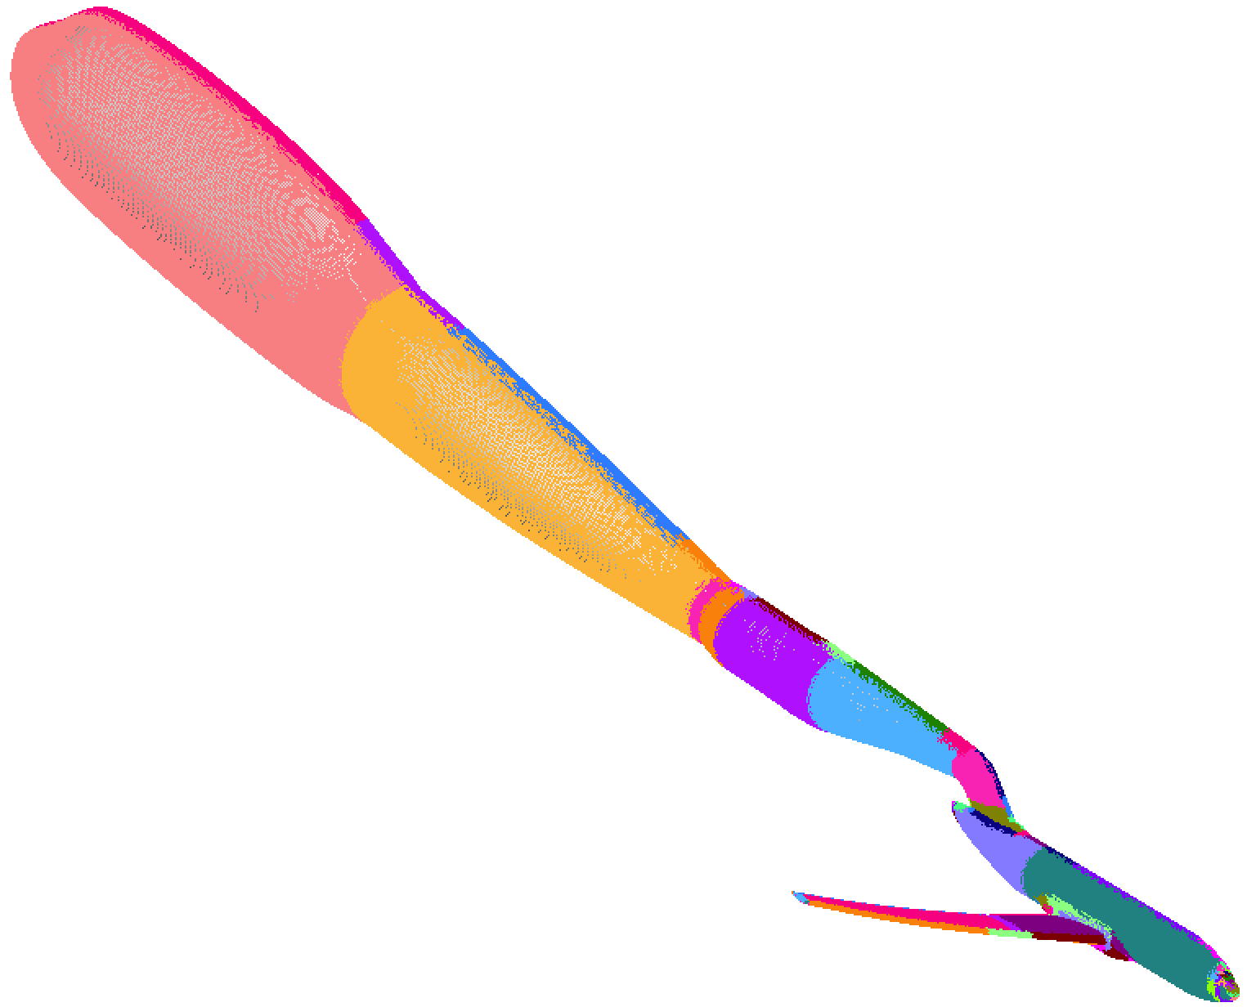
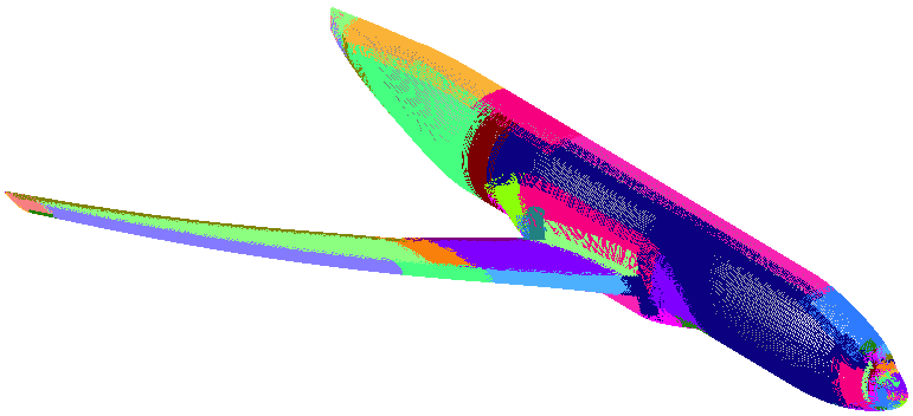



AIAA DRAG PREDICTION WORKSHOP-8
Wing/Body Tail-On/-Off Sting-On-/Off Study
Wing-body
Wing-body-sting
Wing-body-tail
Wing-body-tail-sting
Meshing turn around time for each case
Run Time 12 – 18 mins
Repair Time 2 – 3 hrs

Slide 16




Manual Vs EPOGS Grids Convergence (LAVA)
Wing/body/tail, M = 0.85, Re = 5x10⁶, α = 3.5º
Jordon Won
UC Davis
L2
L2
L3
L1
L1
EPOGS
EPOGS
L3

Slide 17




OVERFLOW & LAVA on EPOGS Grids
Wing-Body-Tail Sting On/Off Study
Jordon Won
UC Davis
no sting
no sting
sting
sting
sting
sting
no sting
no sting

Slide 18



PROPROTOR
(in progress)
Rotor - spinning
2017 Joby prototype
Vertical Lift Proprotor Noise Test
NASA 14 x 22 ft tunnel
# Surface grids = 73
# Surface pts = 0.16M
Run Time ~ 45 sec
Geometry from scanned model
Two disjoint bodies
Mesh single blade intersected with hub
Duplicate blade component grids to get 5-blade set (not implemented yet)
Blade tip
Nacelle - stationary
Blade/hub junction

Slide 19






NIFTI - Non-Intrusive Flow Distortion Measurements within a Turbofan Intake
AIAA Propulsion Aero Prediction Workshop 7
Sheet body with opening at exit plane
# Surface grids = 108
# Surface pts = 0.2M
Run Time ~ 1 min
Fin
Blade Tip
Blade
x19
Vane
x25
Grid spacing on shroud inner surface not auto-adjusted to resolve blade tip clearance
Blade

Slide 20




STARSHIP
# Grids = 798
# Surface pts ~1.5M
Run time ~ 5 mins
Components included so far
Main body
Fwd flap (x 2) & aft flap (x 2)
Raptors (x 6)
Raceways (x 2)
Drogues (x 4)
New Development
Treatment of rounded nozzle lips
Grid point distribution enhancements on round components
Volume pts ~ 67M
Run time ~ 1m 10s
20 defective meshes
Notes:
Geometry clean up
Manual meshing

Slide 21






AIAA HIGH-LIFT PREDICTION WORKSHOP 6
CASE 2.1 (in progress)
# Grids = 292
# Surface pts ~0.47M
# Orphan pts = 300
Run time ~ 2 mins
Finite-thickness t.e. along open boundary
Node meshes around double saddle points

Slide 22
CONCLUDING REMARKS
EPOGS Toolset part of CGT 3.0 public release (May, 2026)
  First software of its kind that attempts to automate creation of
    Overset surface & volume grids, domain connectivity data
    Input files for flow solver & component aerodynamic loads computation
Original geometry starting point: BREP solid
New geometry starting points can reduce turn around time
  BREP sheet bodies
  BREP-like discretized surfaces & edges, topology data
    OpenVSP output
    Manual construction using various tools: ANSA, Pointwise, CGT, topology script
    Surface triangulation (in progress)
DPW8 sting on/off study shows
  Good agreement in aeroloads between (1) manual & EPOGS grids, (2) OVERFLOW & LAVA
  Convergence rates for EPOGS grids comparable to that of manual grids
Rapid meshing time on recent complex geometry test cases
  (1) SBW, (2) Proprotor, (3) DPW8 wing/body/tail/sting on/off study
  (4) NIFTI engine, (5) Starship, (6) HLPW6 Case 2.1

Slide 23
ACKNOWLEDGEMENTS
Funding from NASA Projects
Subsonic Vehicle Technologies (SVT)
Integrated Methods and Research (IMR)
Subsonic Flight Demonstrator (SFD)
Computational Resources
NASA Advanced Supercomputing (NAS) Facility
Geometry & Data Support
Guy Schauerhamer (CFD Research Corp.)
Jordon Won (UC Davis)
Raymond Wang (Princeton University)

